Slide 1
Microsoft Power Automate

Slide 2












Jenkins NS
Modern Workplace Solution Architect | Consultant
15+ Years of experience
Microsoft Teams, Power Platform and SPFx Specialist
International Speaker | Blogger | Trainer
SPS Bangalore Organizer
aOS Ambassador
jenkinsns@gmail.com
in/jenkinsns
@jenkinsns
http://www.jenkinsblogs.com
jenkinsns
https://www.facebook.com/spfxinfo/
https://www.facebook.com/msteamsinfo

Slide 3
Introduction to Power Platform

Slide 4

Notes:
It starts with how they get the most out of their business data
Data is everywhere – generated at every step of our lives
90% of world’s data generated in last 3 years alone
Everything we do, everything our customers do, everything competitors do generates some kind of data
T: In the old world, that data lived in siloes

Slide 5
Low Code Evolution

Slide 6

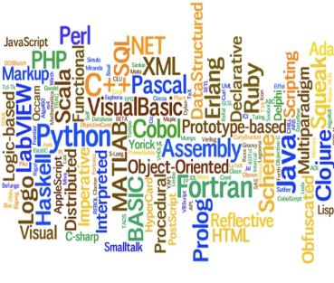


The evolution of how people buy applications
Custom Software
Packaged Software
Low-code Development
What development language do you use?
How feature rich is your software?
How agile and extensible is your platform?
ERP
CRM
HRM
ERP
CRM
HRM
Middle
-ware
MRP
Middle
-ware
PRM
MRP
PRM
MRP
OPS
LOG.
…
OPS
PRM
…

Slide 7
Benefits of low-code development platforms
Environment used to create web or mobile applications easily by mostly configurations, drop-and drops.
LOW-CODE
DEVELOPMENT PLATFORMS
Higher rate of success
Loved by both Business & IT
Breeds Innovations
Days to Weeks
Success Rate
Time to Live
Business Relevance
Innovative Culture
Traditional computer programming, writing lines of codes from scratch.
Failed projects are common
Lagging IT & constant tension with business
TRADITIONAL
DEVELOPMENT
Months to Years
Curbs Innovation

Slide 8






Who buys Power Platform?
“We need faster growth.”
“I need my teams to do a lot more with a lot less.”
CXOs
GROWTH
CFOs
EFFICACY
“We are shackled by our legacy tech. & it’s too risky to migrate!”
“Most of my employees are not desk-bound nor IT-savvy”
CIOs
INNOVATION
BDMs
ACCESSIBILITY
“So many disparate businesses with M&A, I don’t know how to start to integrate.”
“Too many manual or redundant processes because company’s IT or systems don’t work for us.”
COOs
CONSOLIDATION
Users
CITIZEN PAINS

Slide 9
Power Platform loved by businesses in all segments
Enterprise
Corporate
Midmarket
Small
Innovation platform – justify once, unlimited innovations forever
Easy first step to your digital transformation journey
Breeds unique & inclusive IT and Business innovation culture with citizen development philosophy
One Microsoft Story – MS understands business of Platforms
Company-wide digitized with easy-to-use mobile/IoT enabled applications even for frontline workers
Significantly lowered cost of automation, digitization and innovation
Fuss-less continuous innovations with citizen development capabilities
Easy to create, easy to retire, easy to change

Slide 10



Microsoft Power Platform
The low-code platform that spans Office 365, Azure, Dynamics 365, and standalone applications
Innovation anywhere. Unlocks value everywhere.
Power BI
Business analytics
Power Apps
Application development
Power Automate
Process automation
Power Virtual Agents
Intelligent virtual agents
Data connectors
Portals
AI Builder
Common Data Service

Slide 11




Who here has a Microsoft 365 background?
SharePoint, Teams, Exchange…
Microsoft 365
Analyze
Act
Automate
Data connectors
Power BI
Business analytics
Power Apps
Low-code/no-code application development
Power Automate
Workflow automation
Standalone apps
Common Data
Service
AI Builder

Slide 12
What about a Dynamics 365 background?
Sales, Service, Talent…
Microsoft 365
Dynamics 365
Analyze
Act
Automate
Data connectors
Power BI
Business analytics
Power Apps
Low-code/no-code application development
Power Automate
Workflow automation
Standalone apps
Common Data
Service
AI Builder

Slide 13
Last, but not least, what about Azure?
Azure SQL, Azure Functions…
Microsoft 365
Dynamics 365
Microsoft Azure
Analyze
Act
Automate
Data connectors
Power BI
Business analytics
Power Apps
Low-code/no-code application development
Power Automate
Workflow automation
Standalone apps
Common Data
Service
AI Builder

Slide 14
Why Power Platform?
Time
Resources
Cost
Data
Maintenance

Slide 15
Power Platform Components
Power BI
Business analytics
Power Apps
Application development
Power Automate
Process automation
Power Virtual Agents
Intelligent virtual agents

Slide 16




Let’s talk about data
Analyze
Power BI
Know
Act
Automate
Power Apps
Automate
AI Builder
Learn

Slide 17
Let’s talk about data
Analyze
Power BI
Know
Act
Automate
Power Apps
Automate
Connectors
AI Builder
Learn

Slide 18

Let’s talk about data
Analyze
Power BI
Know
Act
Automate
Power Apps
Automate
CDS
AI Builder
Learn

Slide 19

Two Types of Data. . .
External
Internal

Slide 20
Two Types of Data. . .
Connectors
Common Data Service

Slide 21
Oh, the apps you can build. . .
Client | Connectors | Common Data Service
Power Apps (Canvas) | Yes | Yes
Power Apps (Model) | No | Yes
Power Portals | No | Yes
Flows | Yes | Yes
AI Builder | No | Yes
PowerBI | Yes | Yes

Slide 22
Why external data (Connectors)?
It’s easy
It’s home

Slide 23

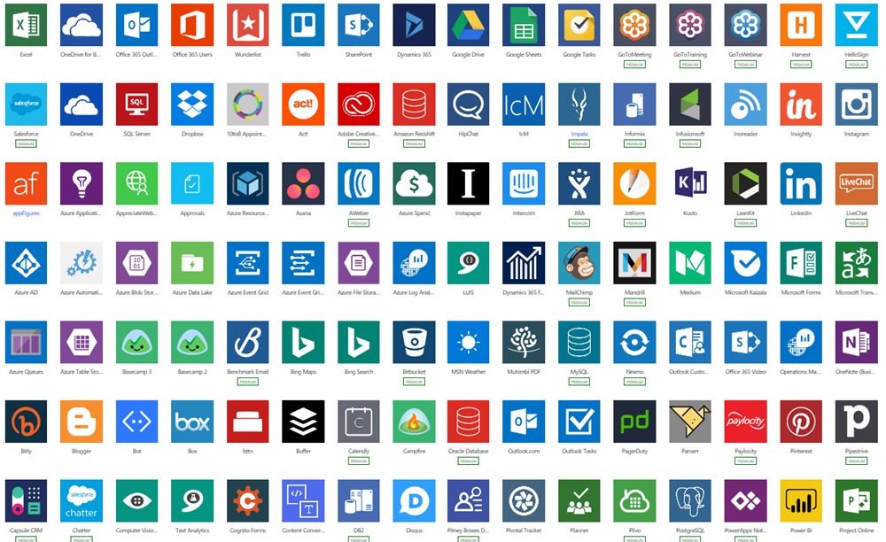
Why external data (Connectors)?
Built-in connectivity to 300+ cloud services, content services, databases, APIs, etc.
Seamless hybrid connectivity to on-premises systems via the on-premises data gateway.
Develop and register custom connectors as a building block for citizen developers.
Connect data silos by using multiple data sources in a single application.

Slide 24
Why internal data (Common Data Service)?
It’s smart
It scales
It’s secure

Slide 25
What is the Common Data Service?
The Common Data Service easily structures
a variety of data and business logic to support
interconnected applications and processes
in a secure and compliant manner

Slide 26

Module 1
What is Microsoft Flow
Microsoft Flow Basics
Types of Flows
Flow Components
Differences between Flows and Workflows
The benefits of automation
How to get to Flow
Setup Environment

Slide 27
Introduction

Slide 28
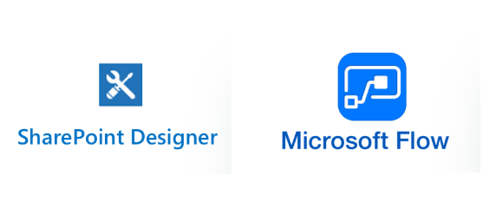
Where we come from
Every organization who has implemented SharePoint must have used workflows to automate their business process. Microsoft provides various options for creating workflows, here we will check SharePoint Designer Workflow vs Microsoft Flow.
There are different ways to create workflows in SharePoint like:
Using Out of box workflow
Using SharePoint designer workflow 2013
Using Visual Studio
Using 3rd party tool
Windows Timer Jobs / Schedulers
And Microsoft has introduced Microsoft Flow in Office 365

Slide 29
Where we come from
Microsoft has not released any new versions of the SharePoint designer after SharePoint designer 2013, no new designer for SharePoint 2016, SharePoint 2019 or SharePoint Online. In workflow architecture also, there are not many changes for any version. Rather Microsoft has invested heavily on Microsoft Flow to provide an alternative to designer workflows (this is not officially announced by Microsoft, but has been assumed based on the functionality provided in Microsoft flow).
Microsoft Flow is nothing but a service which helps to create an automated workflow for your business needs. This Microsoft Flow is a replacement to SharePoint Designer. That means, Instead of Designer Workflow, Now we can simply create a Microsoft Flow and we can use it as per our requirement. Microsoft Flow is basically used to allows users to create cross-application workflows..

Slide 30





What is Power Automate?

Slide 31
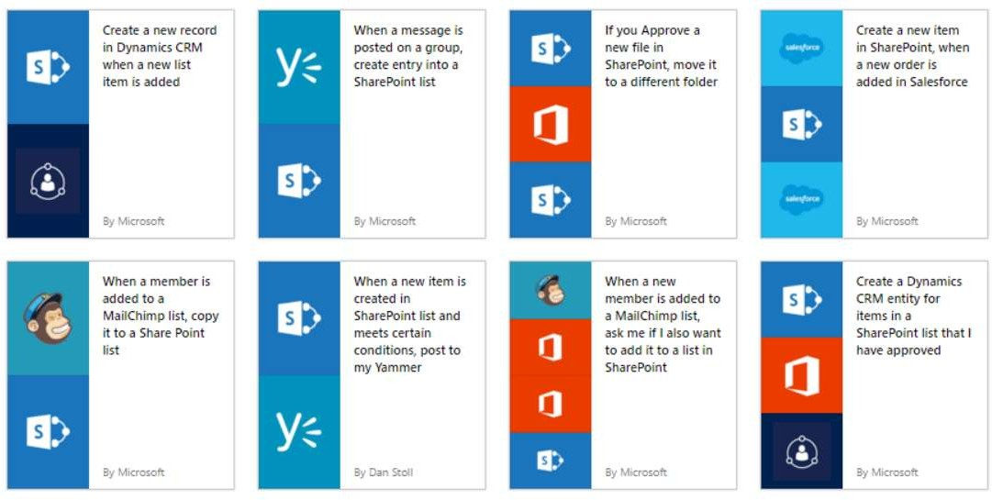
GET STARTED
https://flow.microsoft.com
Source: Microsoft

Slide 32
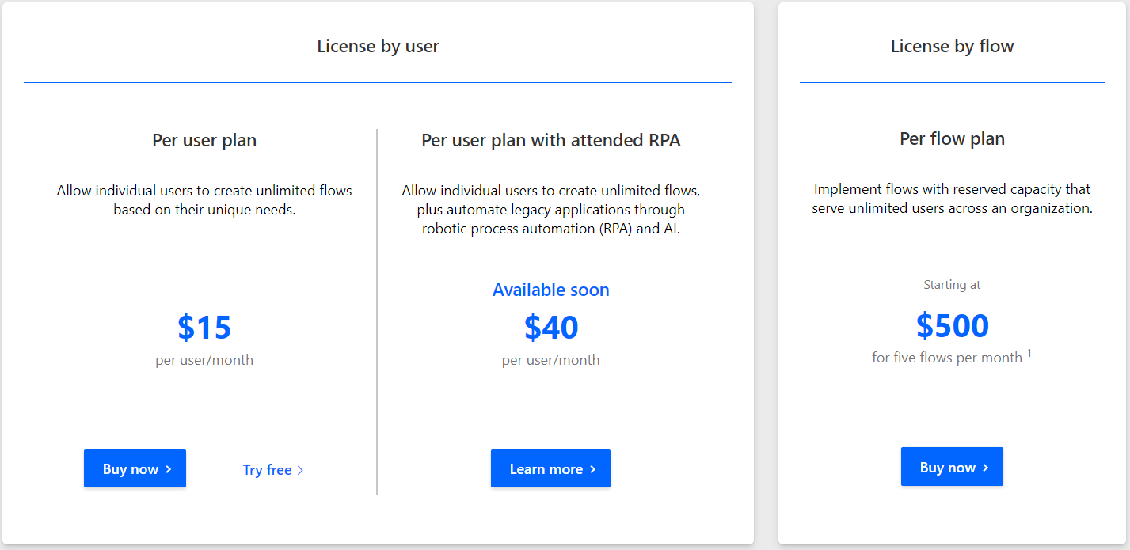
Microsoft Power Automate plan for you
https://flow.microsoft.com/en-us/pricing/

Slide 33
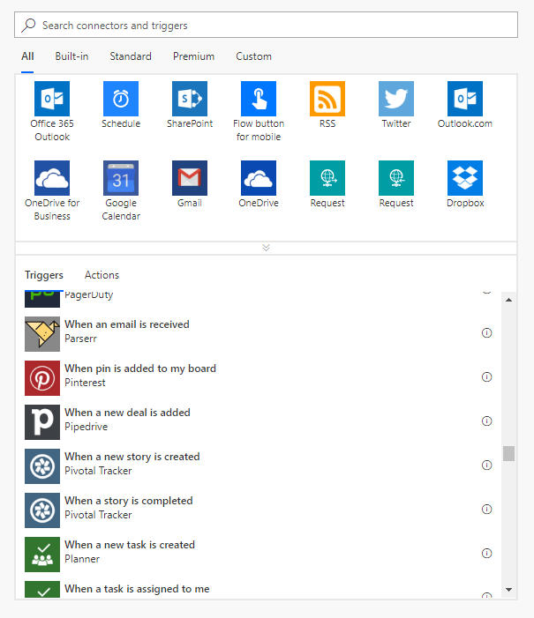
Types of Flows
Scheduled flows
Automated flows
Instant flows
Business process flows

Slide 34
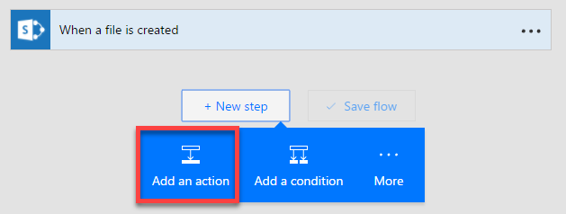
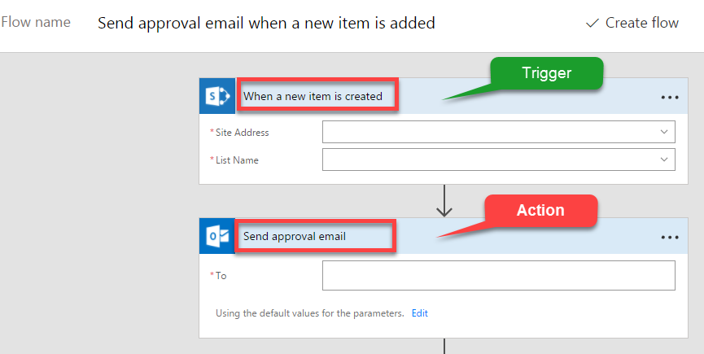
Flow Components
Three major components
Triggers
Actions
Conditions

Slide 35

Differences between Flows and Workflows

Slide 36
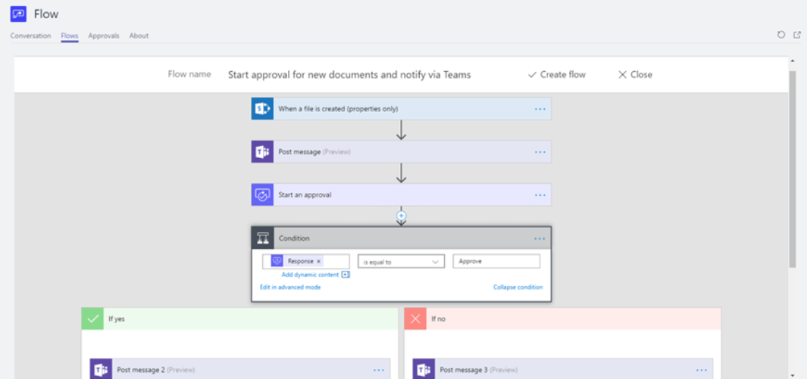
Benefits of automation

Slide 37
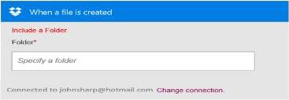
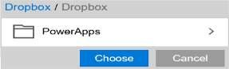
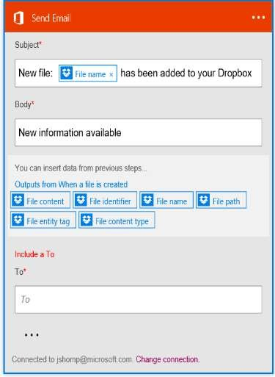
Build your own flows in an easy to use visual designer
Sending an Exchange email when a new file
is added in Dropbox
PowerApps
Authenticate to your Dropbox account.
Select folder to monitor
Choose to include properties from previous step (Dropbox file) to improve relevance
Authenticate to your O365 account.
Build email Subject and Body
Specify Send To email address and additional properties (optional): From, CC, BCC and Importance
Source: Microsoft
Connected to johnsharp@contoso.com

Slide 38
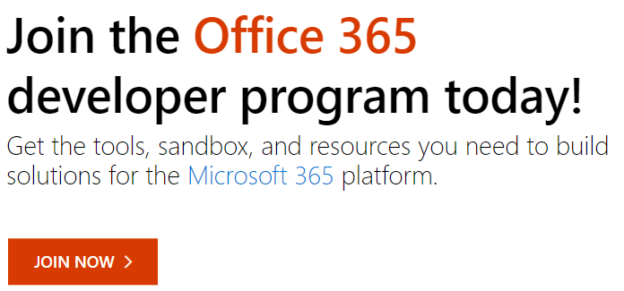
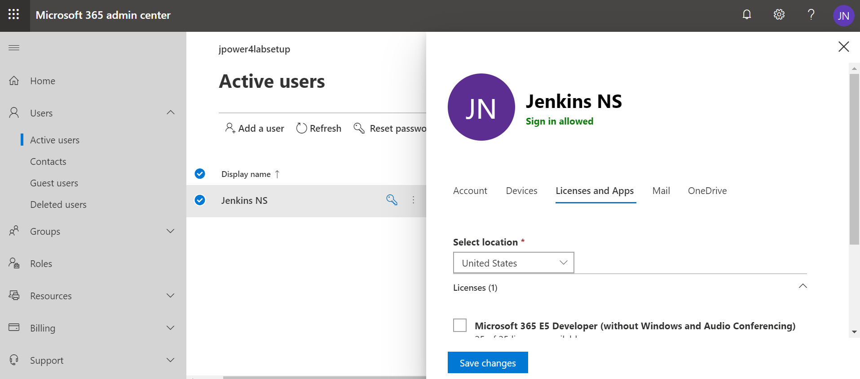
Setup Environment

Slide 39
Module 2
Microsoft Flow Templates
Flow Supported Data sources
Publish a template
Create flows from a Microsoft Teams template
Flows with many steps
Run tasks on a schedule
Watch a flow in action

Slide 40
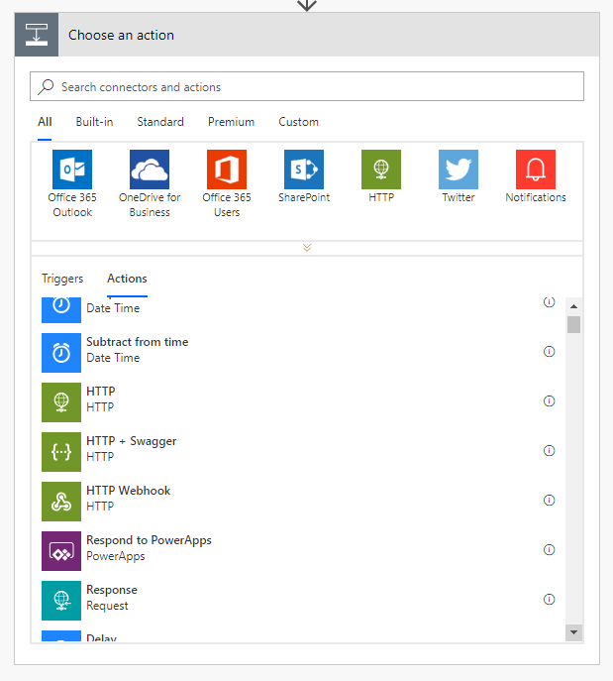
Actions in flows
1+ steps that run after the trigger
Connect to cloud service or on-prem via the on-prem data gateway
Directly connect to HTTP endpoints if there’s no out-of-box connector
Some actions may not even use connections – just manipulate data locally
Custom connectors connect to your own cloud or on-prem REST services

Slide 41
Flowing data
Trigger
Outputs:
File name
Size
File content
Data ‘flows’ from each step and is available for all later steps
Use Add Dynamic Content to select outputs from previous steps
Input types are matched to output types to show a subset of outputs by default
Expressions can be used to convert between data types or calculate derived values
Action 1
A binary field would see:
File name
Size
File content
Outputs:
Title
Count
Action 2
A string field would see:
A number field would only see:
File name
Size
File content
Count
Title
Size
Count

Slide 42
Demo & Hands-on

Slide 43
Module 3
Adding conditions
Designing switches
Using apply to each
Configuring do until logic
Adding a scope

Slide 44

Using expressions
Many reasons to use expressions:
Convert types
Perform simple, inline calculations like string manipulation or arithmetic, or date/time manipulation
Generate data like the current time, a GUID or a random number
Handling optional values
“If” conditional statements / control flow
Working with lists
?

Slide 45
How to create expressions
1
Add Dynamic Content
Dynamic content
Dynamic content
Expression
2
Expression
fx
replace(body('Get_record')?
OK
Action name
3
Inputs
fx
replace(…)

Slide 46
Anatomy of an expression
fx
replace('Title: placeholder', 'placeholder', 'Flow')
Expression name: replace
One or more parameters, separated by commas
Use single quotes around static text
Include expressions in other expressions

Slide 47
Other expressions
body(stepName)
Returns an object with all properties of a different action
triggerBody()
Like body() but for trigger output.
item()
Used to reference the current item in Apply to each
Also used for actions that take an array and manipulate them
variables(variableName)
Reference a variable

Slide 48
Data types and formats
Strings – aka text
Normal – 'Example string'
Email, URL, phone number, etc…
Base64
Binary content
Data URI
URI component
For strings use single quotes
Non-text
Floating-point number – 9.0
Integer number – 137
Boolean – true or false
Array – a list of items
Object – a record with key-value pairs
Do not use single quotes for numbers, integers or Booleans:
'true' does not equal true
[ ]
{ }

Slide 49
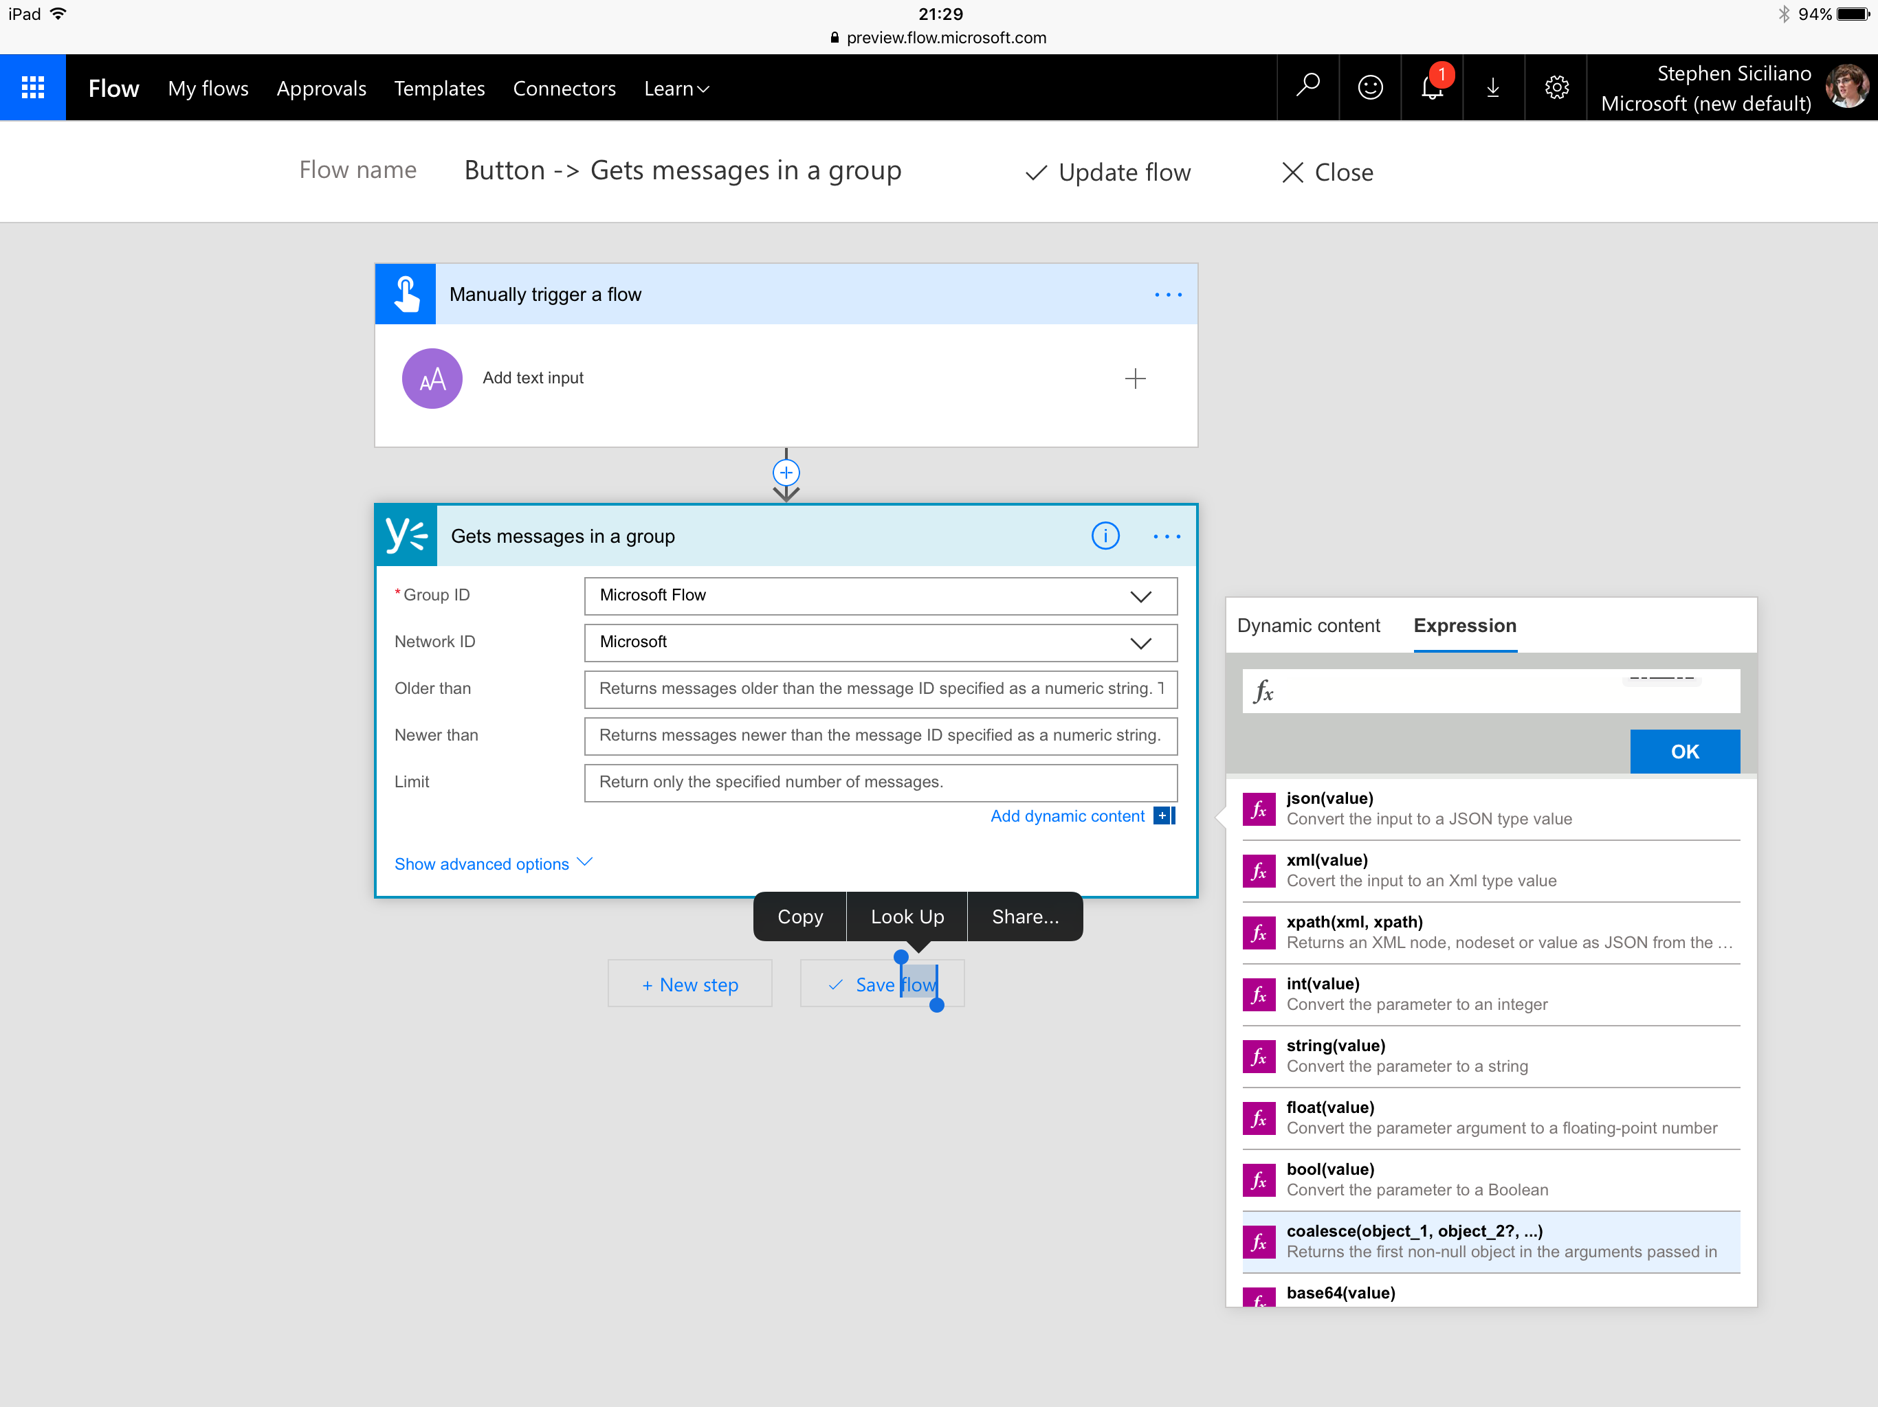
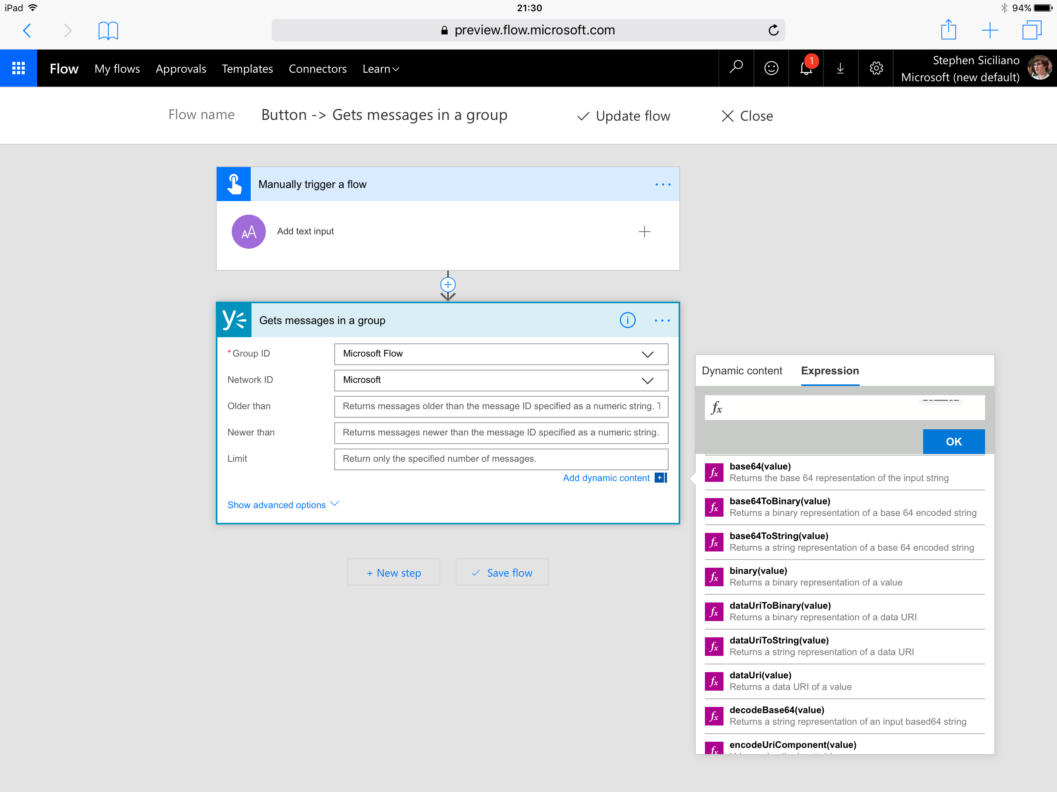
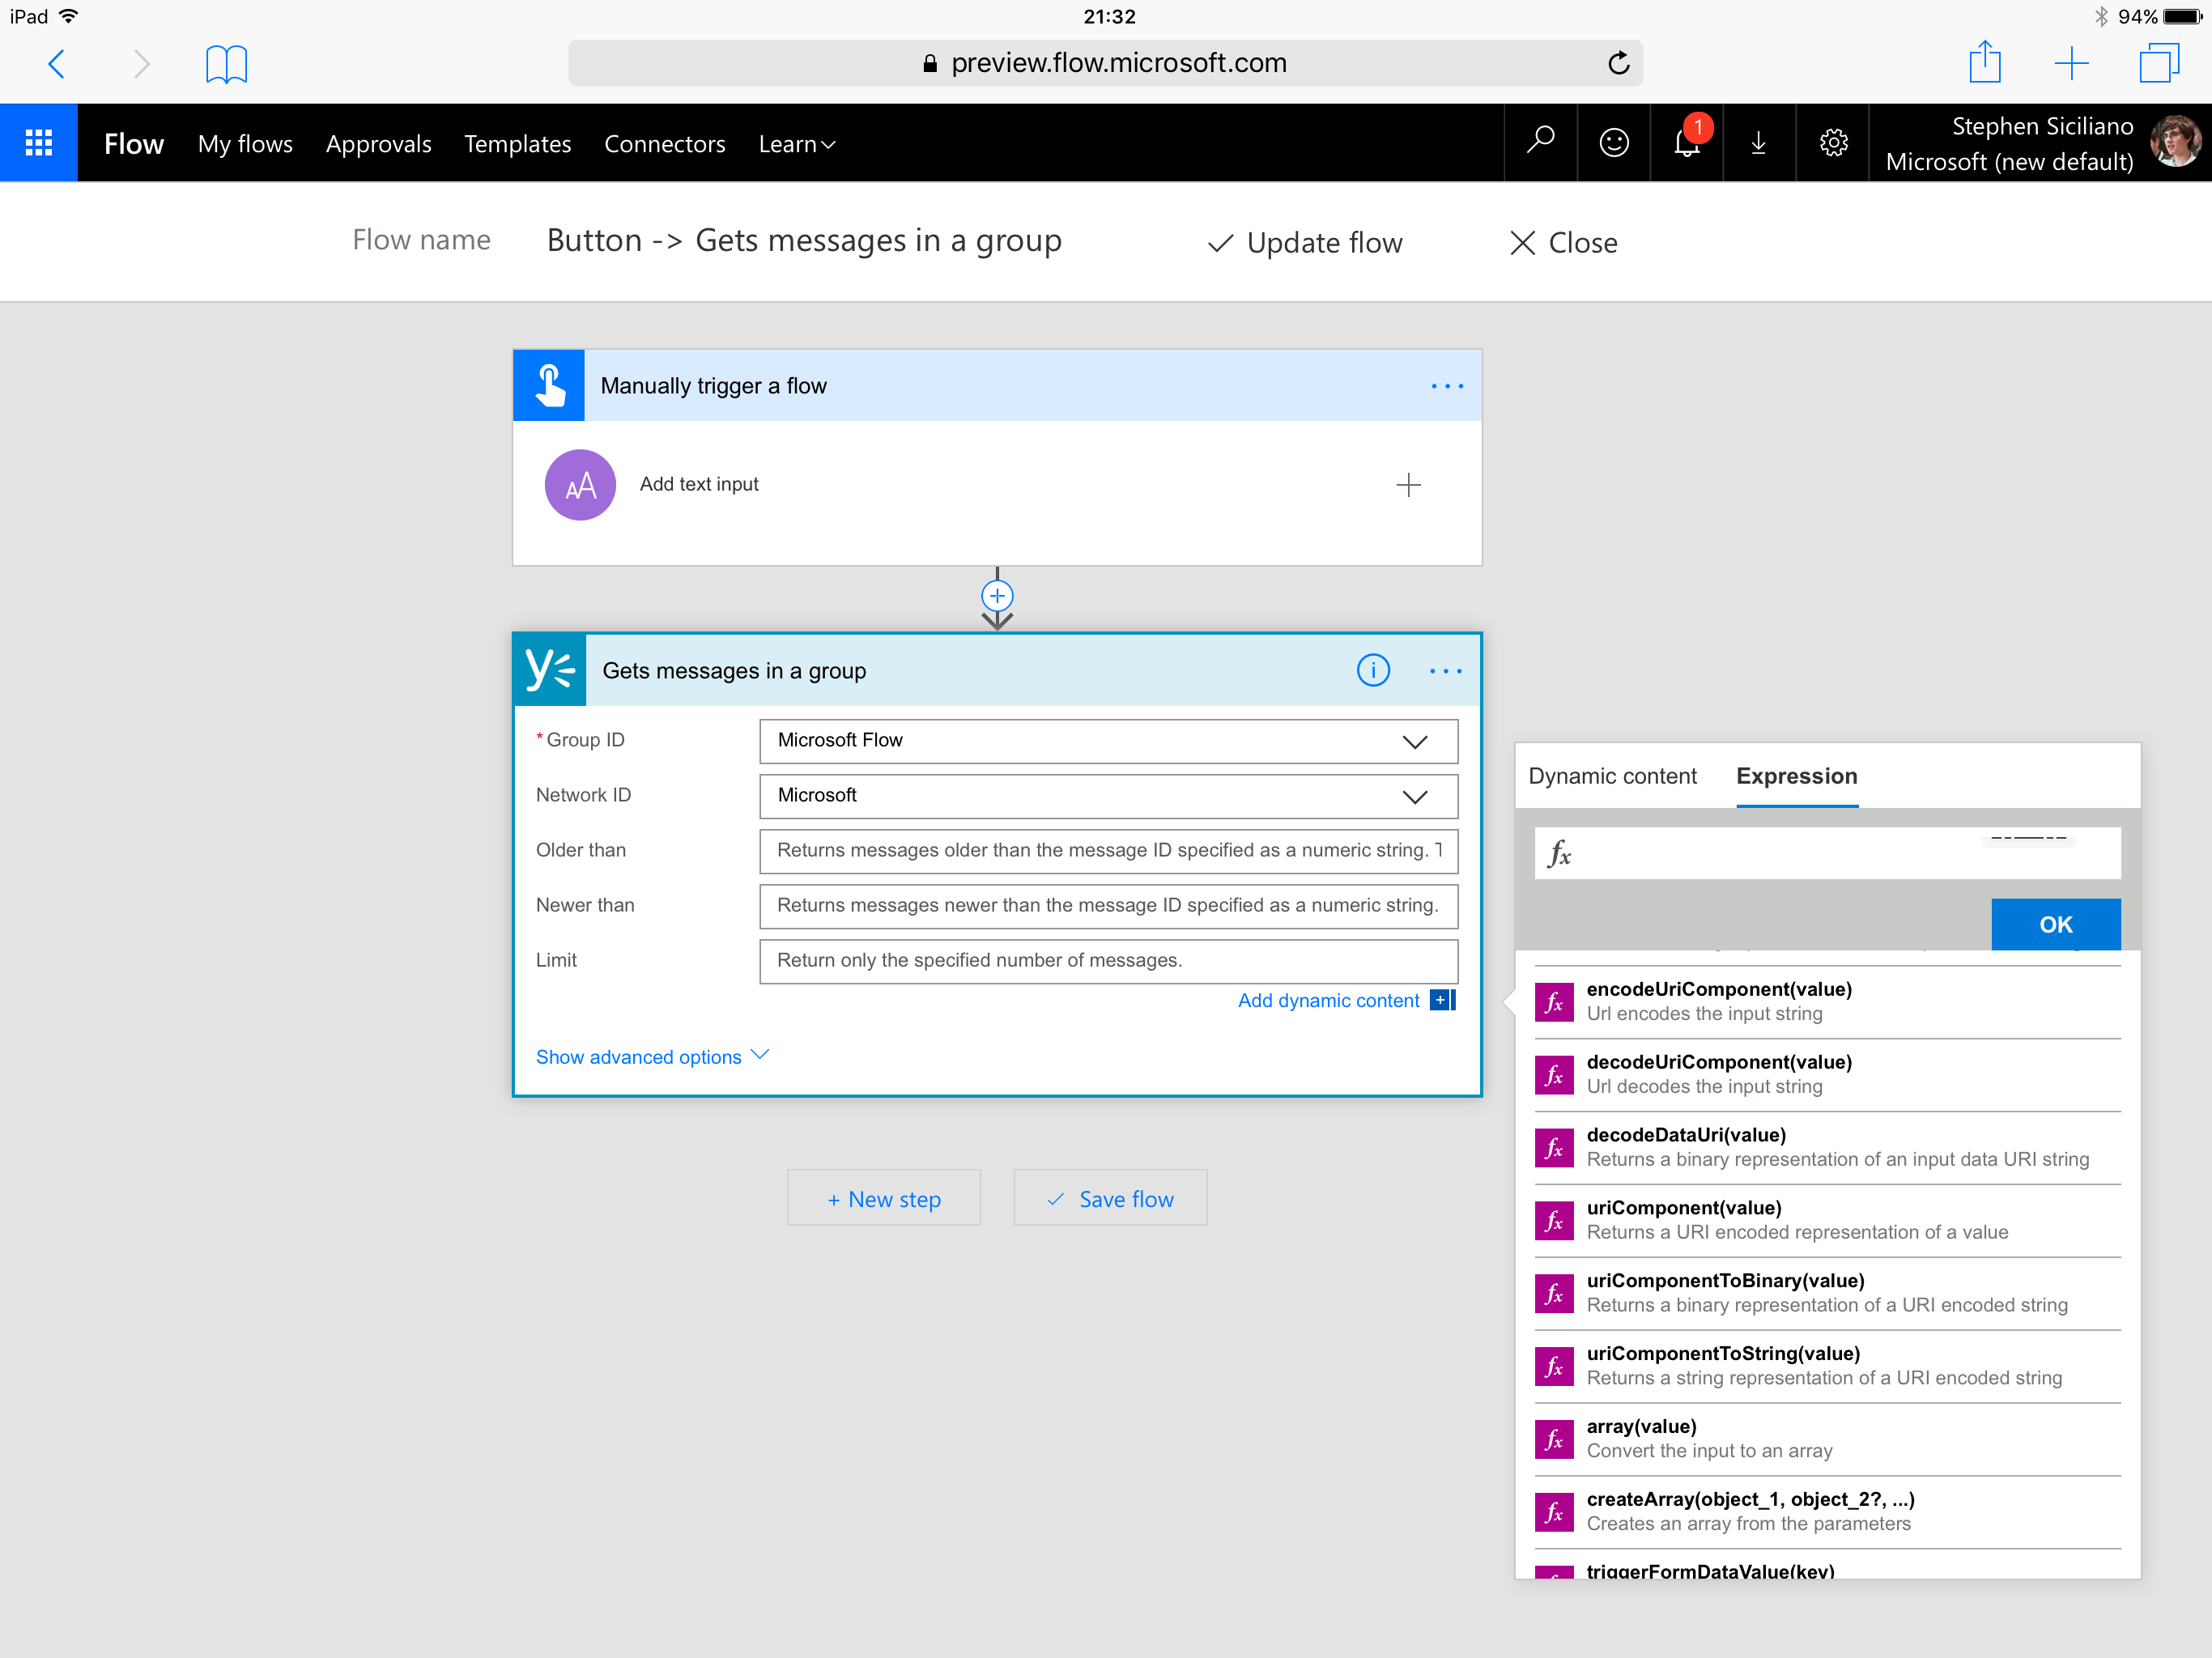
Handling content conversion
Some conversion is automatic (i.e. integer input into string field)
In some cases, a conversion expression is automatically added by the UI
Other conversions you’ll need to author an expression for directly
The expression is named for the destination type
For example to convert to base 64, use the base64() expression

Slide 50
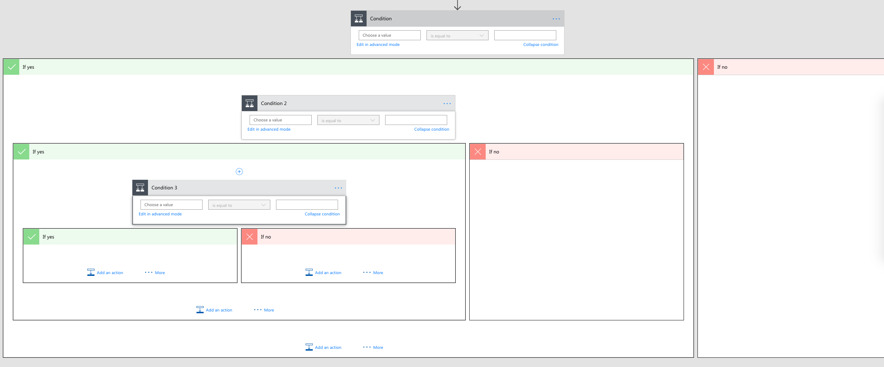
The if() expression
Why use the if() expression if you can use a condition?
Avoid multiple nested conditions just to set a field
Caution: The if does not ‘short circuit’ which can result in errors if you try to reference a missing property in one branch

Slide 51
Handling optional values
Caution: trying to use a property that’s not set – aka “null” -- will cause the flow to fail
Two steps to handle:
Use the “?” character after selecting the property (this happens automatically). Use when chaining access to sub properties.
Then, use the coalesce() function to provide a default value
coalesce(body('Get_record')?['parent']?['child'],'Default Value')

Slide 52
Working with Arrays

Slide 53
What are Arrays?
A few different classes of things you may need:
Repeat an action over each list item
Get a single item from a list
Filter a list down
Make a list work with a different action
Jane
8.29
ID: 123
Name: Jane
Mail: J@a.c
Dan
4.89
ID: 888
Name: Bob
Mail: B@a.c
Steve
0.28
ID: 456
Name: Dave
Mail: D@a.c

Slide 54
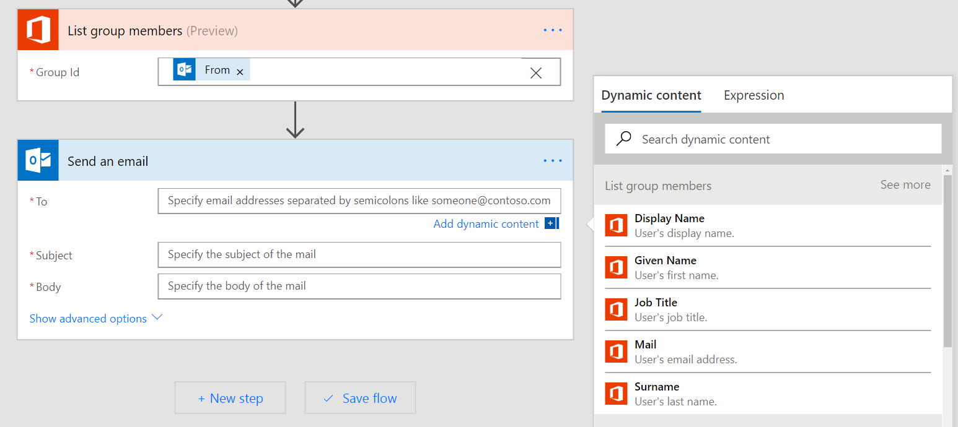
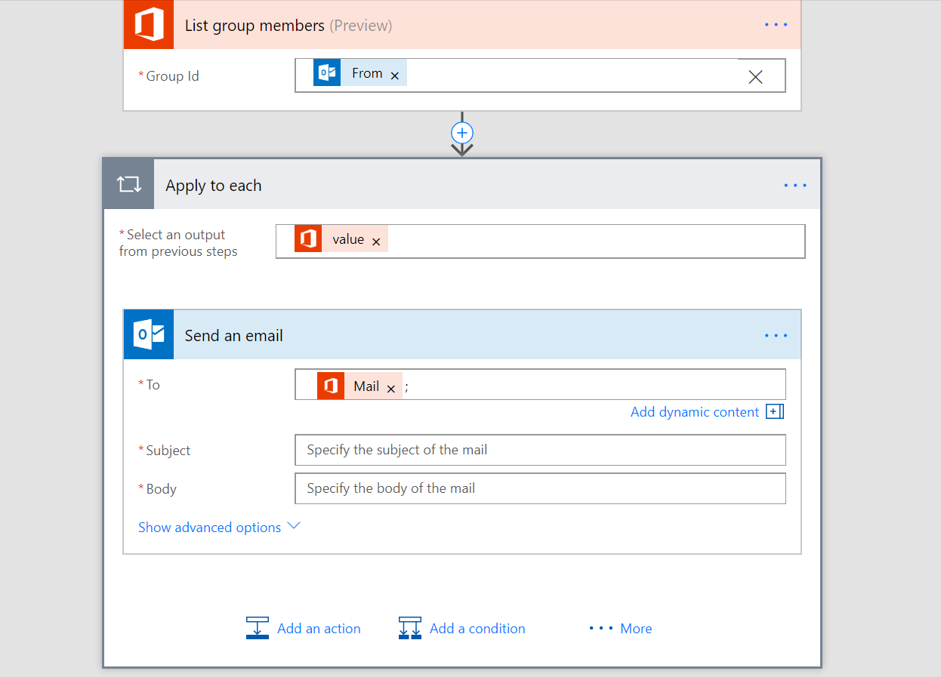
Apply to each
Automatically added when you try to use an output that’s part of a list
Destination step to repeats over every list item
If you do NOT want this you can:
Get only one list item using an expression, or,
Convert the whole list to a string in the form of a list or a table

Slide 55

Getting certain list items
0
Use the first() expression to get the first item from a list
Use square brackets and a number (starts at 0) to get a certain item, for example [2]
Use the last() expression to get the final item
1
2
3
Note: If the array is a list of Strings, Numbers, Booleans etc…, then the above expression can be used directly. However, if it is an array of objects, you will need to use square brackets to select the specific property you need:
last(body('Get_rows')['value'])['mycolumn1']
body('Get_rows')['value'][2]['mycolumn1']

Slide 56
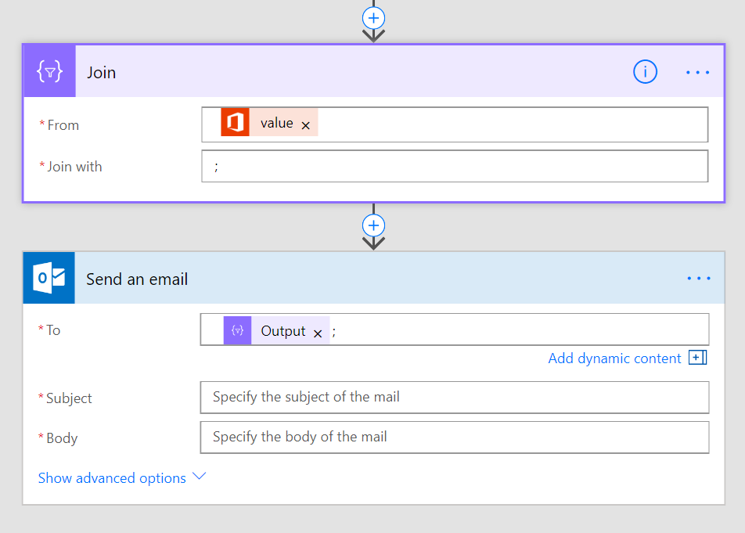
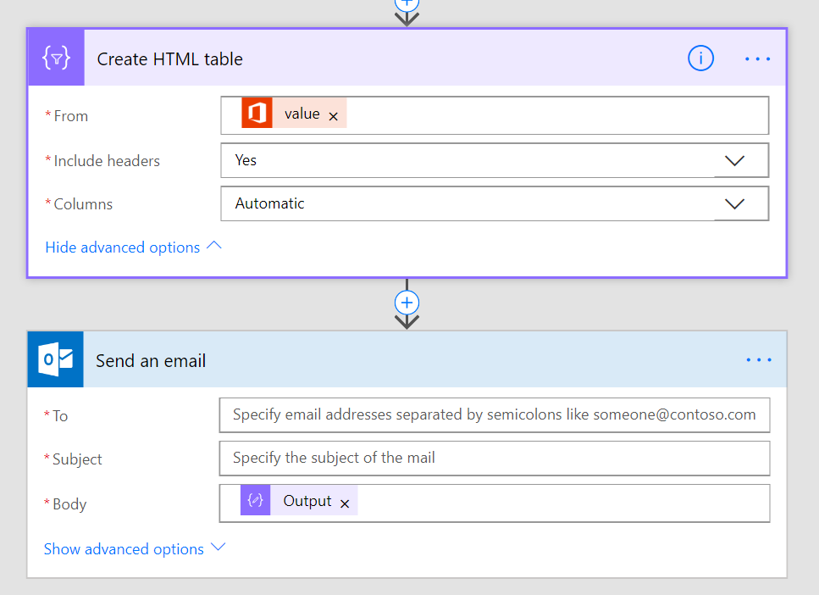
Convert the list to a string
Join – use join to get a simple list, for example, if you have a list of email addresses*
Create HTML/CSV Table – convert a list of Objects to a tabular display format, for example, for inclusion in the body
* Note: You must have a list of strings, not a list of Objects. Use Select if you want a sub-property of each object.

Slide 57
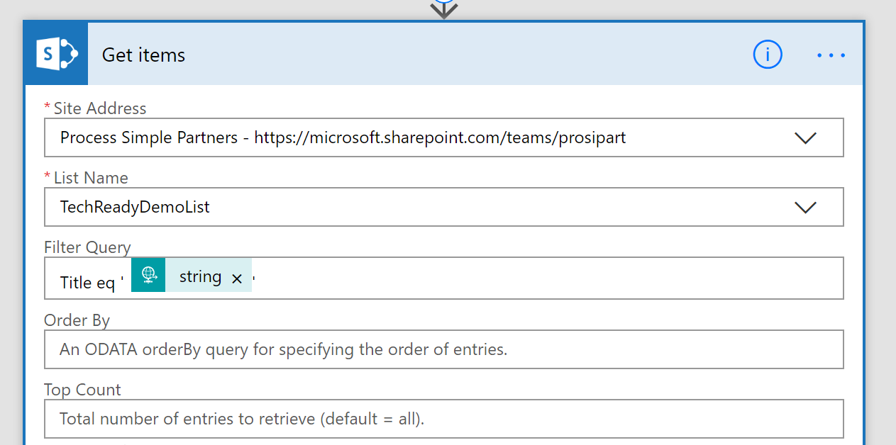
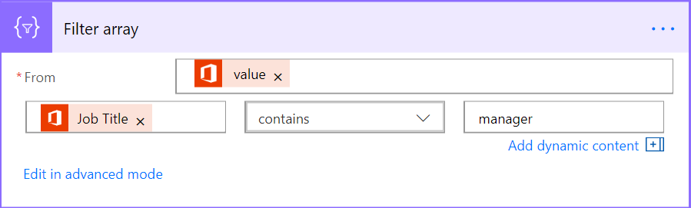
Filtering
Ideally – have the connector do the filtering for you
Requires use of OData syntax and is limited. Read more here.
Built-in Flow action – Filter array
Select the Array in the From field
Can either use simple or advanced mode just like for Conditions
If you need the first N items you can use take() or skip()

Slide 58


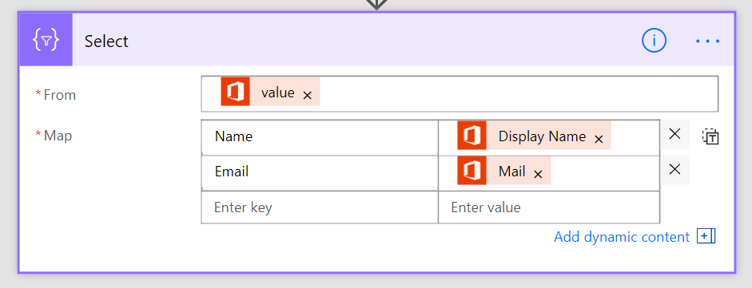
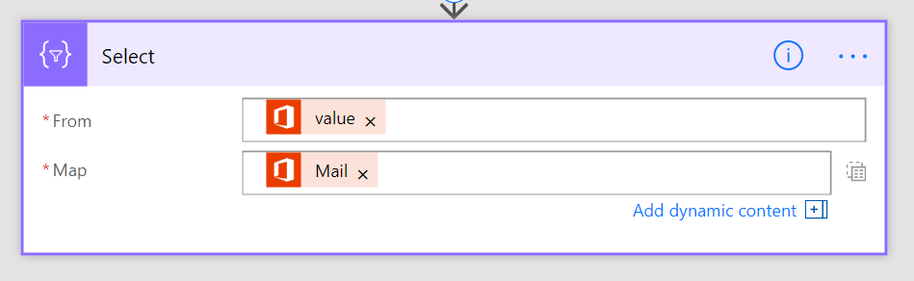
Transforming Arrays
Two input modes: fill key-value pairs, or typing expressions directly in
Create an array of objects
Create an array strings, numbers, booleans, etc…
Useful for passing this Array to another action
Useful for getting a simple list, for example, of email addresses

Slide 59
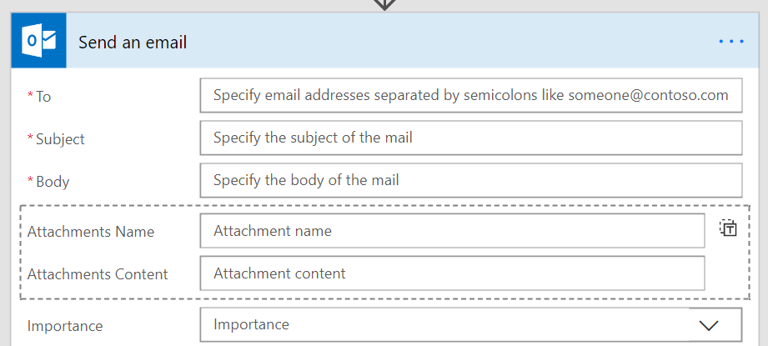
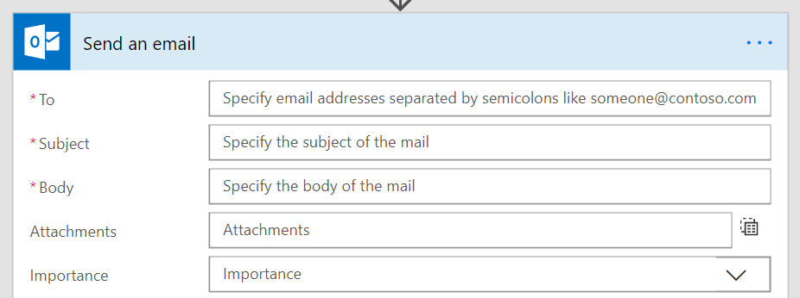
Passing data into arrays
Can hardcode a list – or – have the list be dynamic at runtime
Fill in each property of the object and get one item created
Need to pass in an Array that exactly matches the fields

Slide 60

Checking list containment or duplicates
You can use the contains() expression to see if something is in an array
Use the union() function with the array twice to get a set of unique items

Slide 61
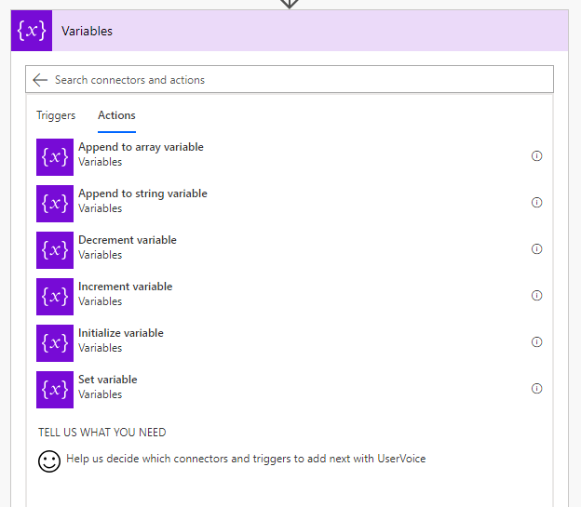
Variables
Define the type and initialize the variable before you use it.
Useful for:
Counters – you can increment or decrement variables
Append to arrays or strings
Set state, check it elsewhere in the flow
Simplify expressions – no need to keep checking object?[‘p1’]?[‘p2’]?[‘p3’]

Slide 62
Escaping rules
When you directly are using the expression language you may need to escape certain characters
Using strings with a single quote character:
@substring('It''s A Great Day!',1,5)
Using spaces in action names:
@body('Name_with_spaces')
Building an object you need to escape ‘@’:
{
"@@Odata.type" : ""
}

Slide 63
Module 4
Introducing Microsoft Flow
Create your first flow
Learn to use the Microsoft Flow mobile app
Receive text and email notifications from flows
Copy files with flows
Create recurring flows
Post tweets with Microsoft Flow
Create team flows
Troubleshoot flows

Slide 64
Control flow and action settings

Slide 65
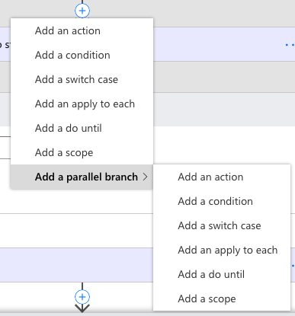
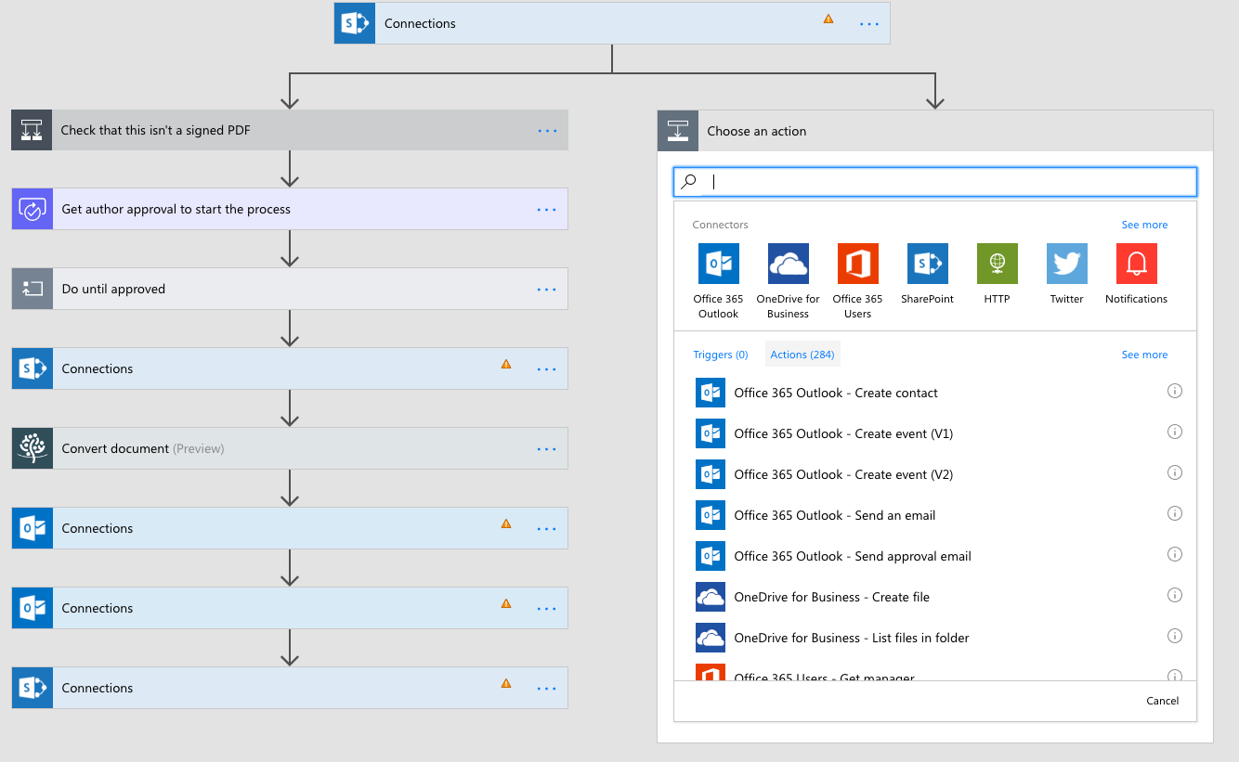
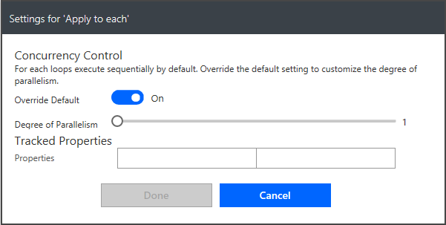
Parallel execution
For actions select Add parallel branch from the above the action
Inside of an Apply to each you can control parallelism

Slide 66
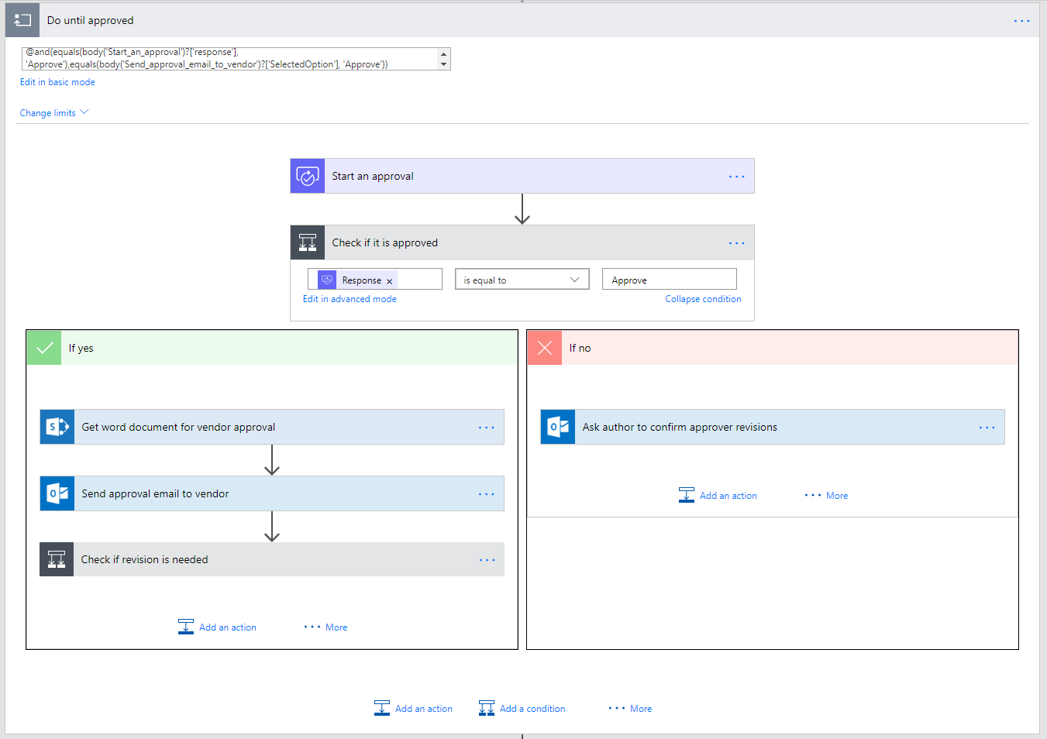
Looping
Stage 1 approval request
Stage 1 Approved?
Do until - actions that you want to repeat until a condition is met
Do something until condition
i.e. Do until an approval is completed
Caution: Executes at least once
Stage 2 approval request
Ask Author to make changes requested by Stg.1
Stage 2 Approved?
Ask Author to make changes requested by Stg.1
Revisions completed?
Mark document as approved

Slide 67
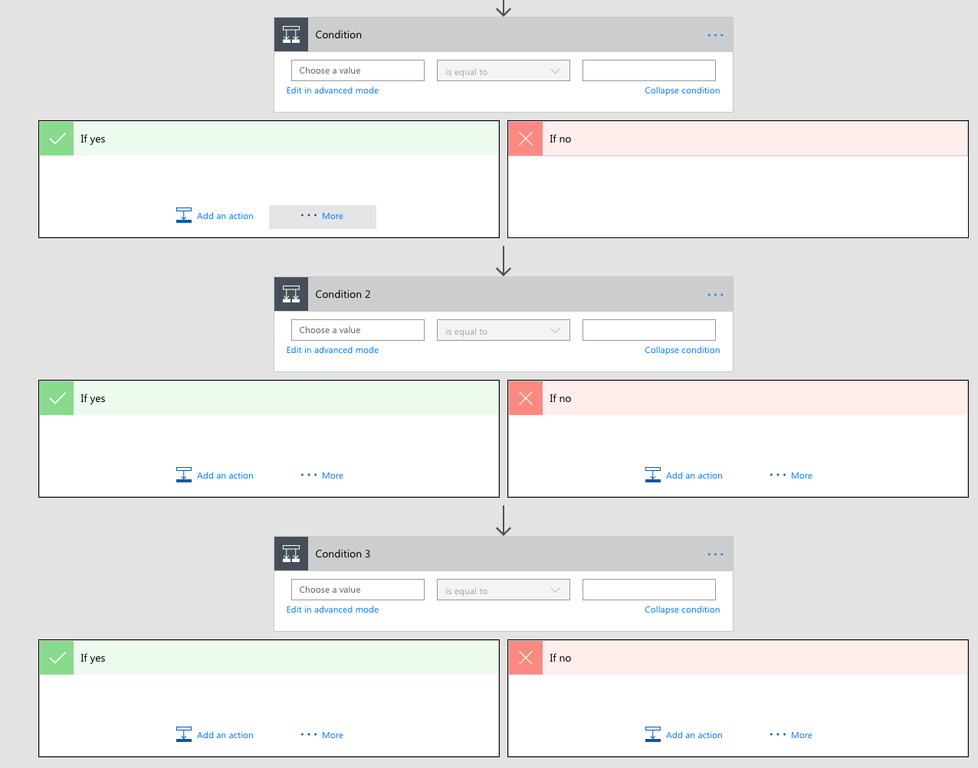
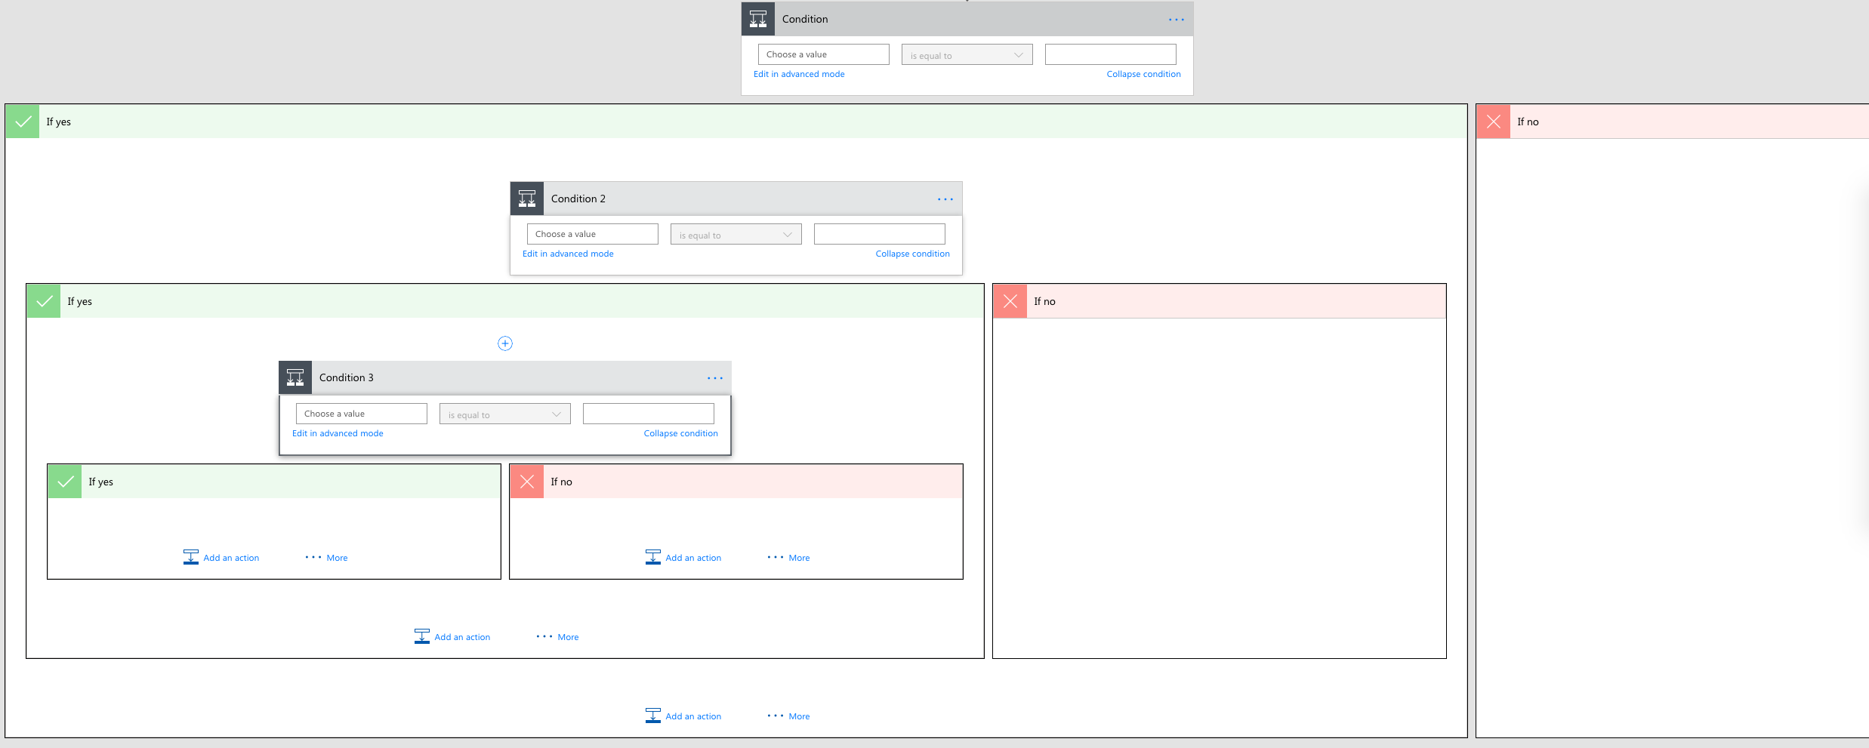
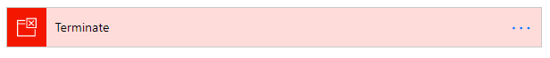
Terminate flows
You can use this action to avoid nested conditions by ending in the middle

Slide 68
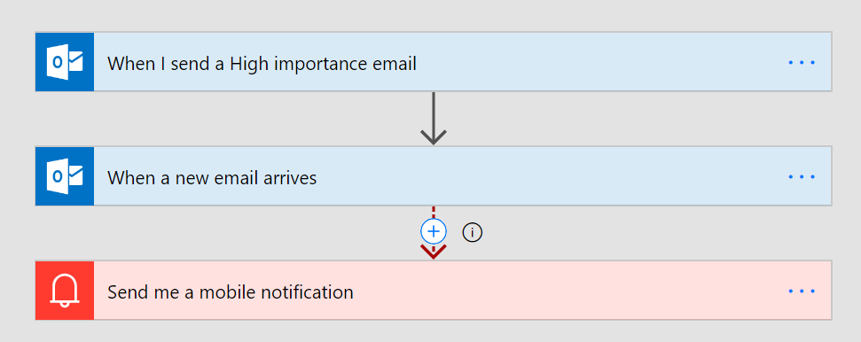
Asynchronous Actions
Any “trigger” can be in the middle of a Flow as well
For example, create a flow that waits for a reply to a certain thread in the middle
You probably want to configure a Time Out and handle that case
Do-Until might also be needed if other unrelated events may trigger

Slide 69
Module 5
Learn to build more complex flows
Build an approval request
Build a flow that processes an approval request
Create a flow that stores documents
Build a flow that uses information like locations or date
Build a flow accepts user input when run
Learn to build a flow that runs at recurring time intervals
Build a flow that runs when an event in Dynamics 365 occurs
Build a flow that uses SQL
Integrate PowerApps, Flow, and SharePoint
Create a business process flow
Create a business process flow that has conditions
Monitor flows
Sharing Flows

Slide 70
Approval Workflow

Slide 71
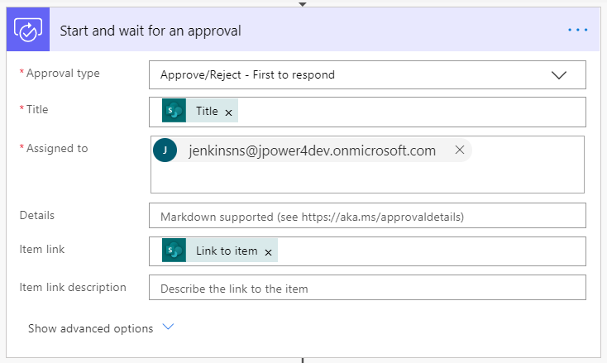
Approve / Reject Workflow
With Power Automate, you can manage the approval of documents or processes across several services, including SharePoint, Dynamics 365, Salesforce, OneDrive for Business, Zendesk, or WordPress.
To create an approval workflow, add the Approvals - Start an approval action to any flow. After you add this action, your flow can manage the approval of documents or processes. For example, you can create document approval flows that approve invoices, work orders, or sales quotations. You can also create process approval flows that approve vacation requests, overtime work, or travel plans.
Notes:
https://support.microsoft.com/en-in/help/4513676/differences-between-flow-approval-actions

Slide 72
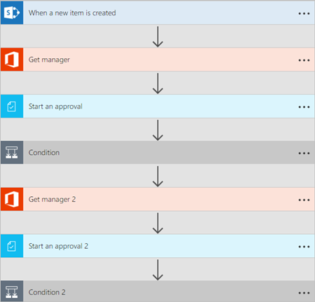
Sequential approval flows.
Some workflows require pre-approval before the final approver is required to sign off. For example, a company may have a sequential approval policy that requires pre-approval for invoices over $1000.00 before they're approved by the Finance department.

Slide 73
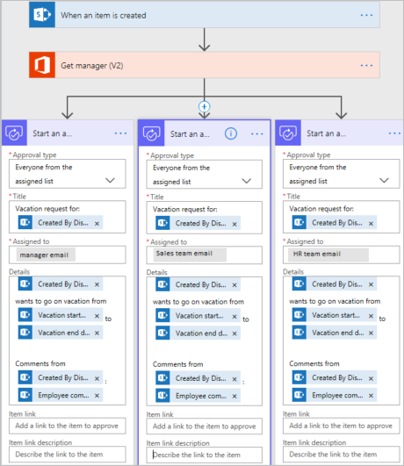
Parallel approval flows
In a parallel approval workflow, multiple persons are required to approve items such as invoices, purchase orders, vacation requests, etc. Each person's approval is independent of all other approvers.

Slide 74
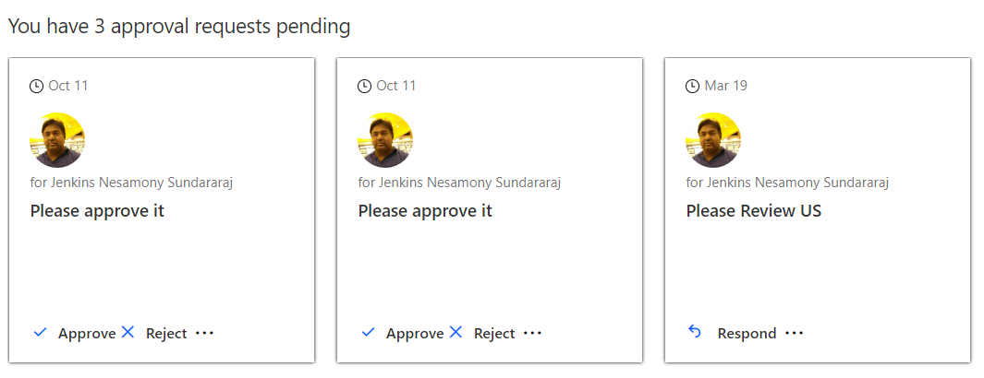
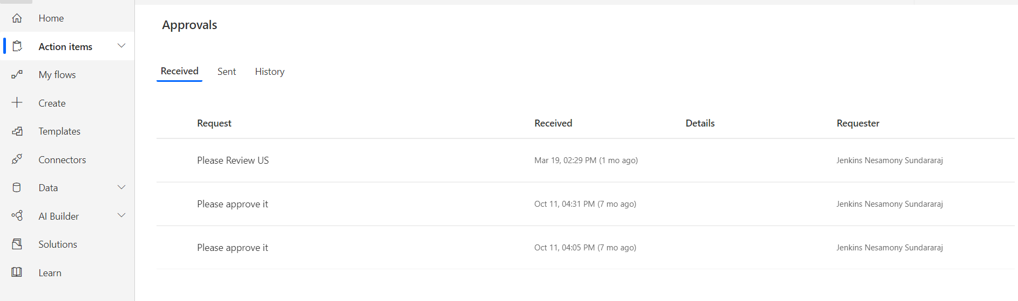
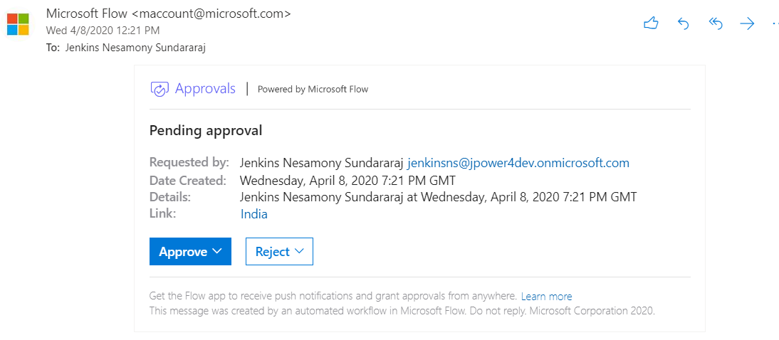
View and manage pending approval requests
Power Automate - Home Page
Power Automate – Action Items -> Approvals
Email

Slide 75
Recurrence Workflow

Slide 76
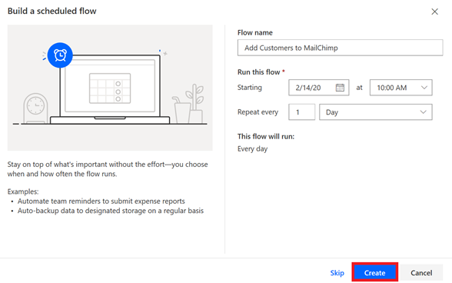
Recurrence flow
Create a flow that performs one or more tasks (such as sending a report in email):
once a day, an hour, or a minute
on a date that you specify
after a number of days, hours, or minutes that you specify

Slide 77
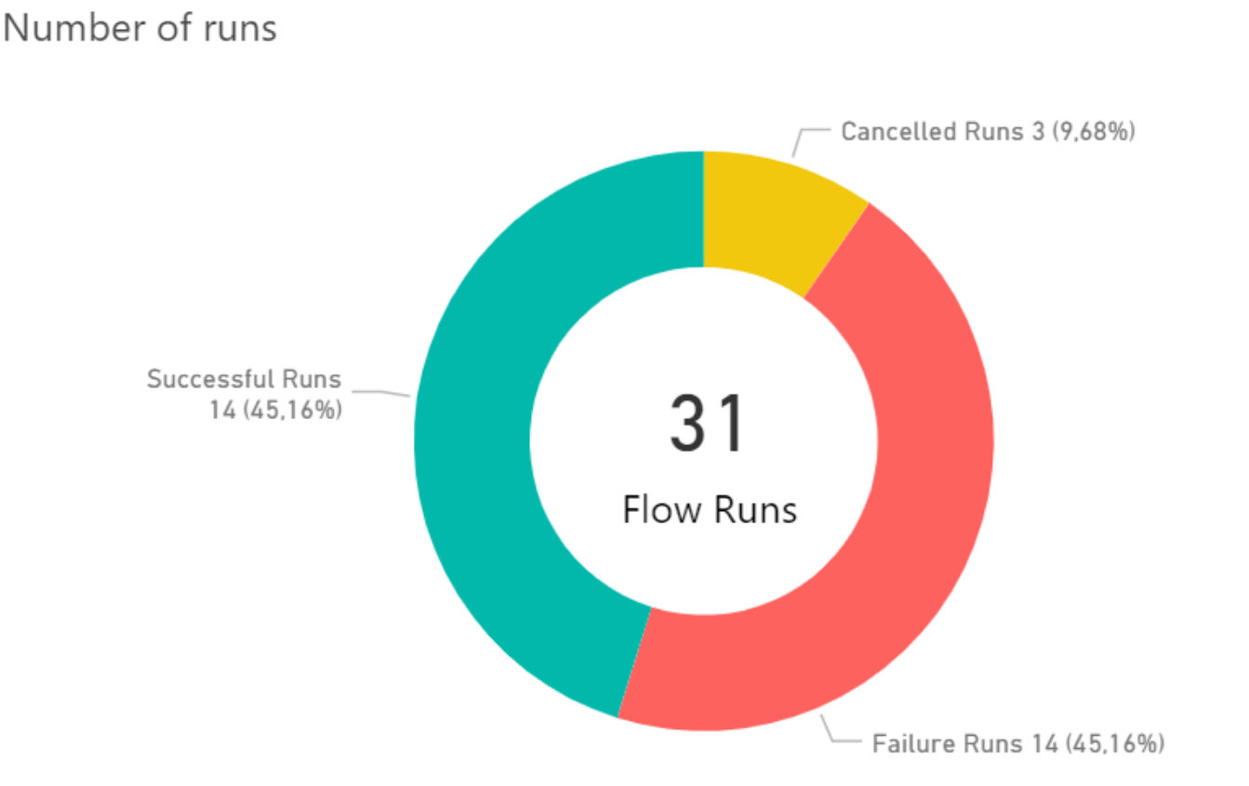
Errorless workflows

Slide 78
Normal action execution
Run in sequence
Flow terminates once an error (failure or timeout) is encountered
Skipped means the previous action didn’t run
Summary: four possible states for an action:
Succeeded
Failed
Timed out
Skipped

Slide 79
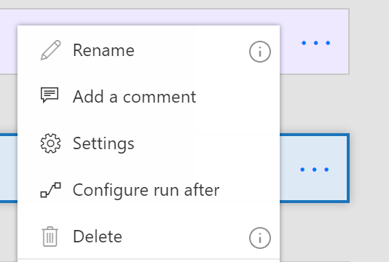
Action settings
The “…” menu contains entry points to Settings and Configure run after
Settings lets you configure:
Async Actions
Timeout
Retry policy
Sequential
And more!

Slide 80
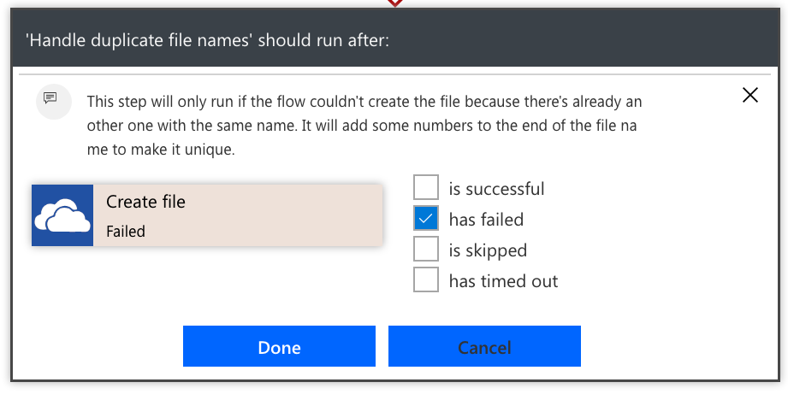
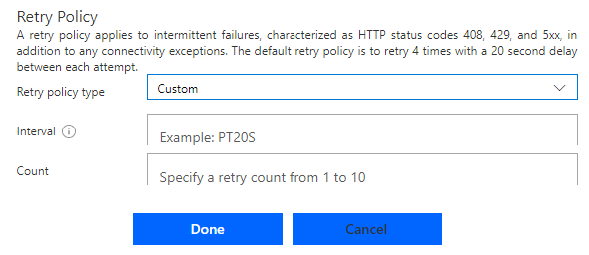
Error handling
Select the Run After option in the action menu
Choose which error conditions, the arrow will turn dotted red
Use parallels for errors that aren’t at the end of the flow
Retry policy by default handles transient failures
Recommended to choose exponential policies as they can go for a long period of time

Slide 81
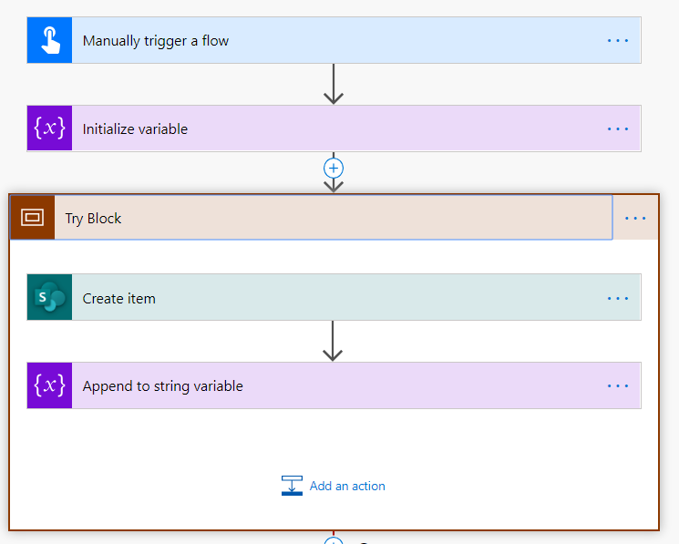


Try, Catch, Finally and Scope
Scopes are a simple way to group two or more actions together. When you put actions inside a scope, they can be visually collapsed so that you cake make the presentation inside of the designer much simpler.
Try – The “Try” scope should contain all the actions from the main flow of the process.
Catch – The “Catch” scope is configured to run after “Try” block is failed. This is implemented using “Configure run after “ feature .
Finally – The “Finally” block should run no matter what happens in the previous action.
Using “Scope” and “Configure run after” feature, we can implement try ,catch pattern in Power Automate easily.

Slide 82
Power Apps Integration flow

Slide 83


Power Apps Integration flow
You can use Power Automate to create logic that performs one or more tasks when an event occurs in a canvas app. For example, configure a button so that, when a user selects it, an item is created in a SharePoint list, an email or meeting request is sent, a file is added to the cloud, or all of these. You can configure any control in the app to start the flow, which continues to run even if you close Power Apps.

Slide 84
SQL Server Integration flow

Slide 85

SQL Server Integration flow
Microsoft SQL Server is a relational database management system developed by Microsoft. Connect to SQL Server to manage data. You can perform various actions such as create, update, get, and delete on rows in a table.

Slide 86
Calling Microsoft Flow from your application

Slide 87


Calling Microsoft Flow from your application
Microsoft Flow allows you to turn complex repetitive tasks into automated multistep flows.
In many cases, you want your flow to be triggered by an event, such as a document update.
In others, you want to let the end user initiate a flow. In this case, Microsoft Flow will serve as an integration glue between your application and large number of other services.
For example, you may want the user to click on a button and send an email to her customers.

Slide 88
Azure Cognitive Services AI Integration flow

Slide 89


Azure Cognitive Services AI Integration flow
Language Understanding (LUIS) is a cloud-based API service that applies custom machine-learning intelligence to a user's conversational, natural language text to predict overall meaning, and pull out relevant, detailed information.
Azure cognitive services language understanding intelligent service (LUIS) lets you understand language contextually, so your apps communicate with people in the way they speak.
The LUIS integration in Flow enables you to make predictions on a query string.
You can design your Flow to execute a set of actions when the desired intent is detected.

Slide 90
Module 6
Standard and premium connectors
Connecting to web services
Using Flow with on-premises data

Slide 91
Connectors

Slide 92
Why build a connector?
Enterprise developers
Looking for connectivity to a service we don’t currently support
Need connectivity to a custom or internal service
Partners and ISVs
Expand the number of services you integrate with
Provide the extensibility your customers need
Increase exposure and adoption

Slide 93
Building a Custom Connector



Develop
Build, secure and describe your API
Import from existing artifacts (Open API, Postman) or build from scratch
Test
Validate your API calls
Use in Flow and PowerApps for E2E testing
Share
Allow other users within your organization to use your connector

Slide 94
Building a Custom Connector




Develop
Build, secure and describe your API
Import from existing artifacts (Open API, Postman) or build from scratch
Test
Validate your API calls
Use in Flow and PowerApps for E2E testing
Share
Allow other users within your organization to use your connector
Certify
Share your connector with all users of Flow and PowerApps
Only for Public Connectors

Slide 95
Custom connector architecture
Hosting environment
Connector ID
+
Operation
+
Connection ID
Host
+
Path
+
Credentials
RESTful API
Microsoft Flow
Custom connector
PowerApps

Slide 96
Using your own Web API
Hosting environment
Your
Web API
Microsoft Flow
Custom Connector
PowerApps

Slide 97
Securing your Web API
Hosting environment
AAD Application #1
AAD Application #2
Your
Web API
Microsoft Flow
Custom Connector
PowerApps

Slide 98
Connectors Demo

Slide 99












Custom Connector Resources
https://docs.microsoft.com/connectors
Custom connectors
From Postman Collection
Webhooks
Dynamic values/schema
https://aka.ms/apiconnectors
Submit for certification
Example Video : https://youtu.be/dBCS1nPsDiE
Notes:
https://www.googleapis.com/books/v1/volumes?q=search
https://www.googleapis.com/books/v1/volumes?q=ISBN:9780789748591
Gallery
First(mybooks).items
ThisItem.volumeInfo.imageLinks.thumbnail
ThisItem.volumeInfo.title
ThisItem.volumeInfo.description
Host : www.googleapis.com
Base Url: /books/

Slide 100
Demo & Hands-on
Connect REST API using connector
Notes:
https://docs.microsoft.com/en-us/powerapps/maker/model-driven-apps/embedded-canvas-app-add-classic-designer
https://www.sharepointpals.com/post/step-by-step-procedure-to-call-sharepoint-office-365-rest-api-from-microsoft-flow/

Slide 101
Module 7
Administer flows
Export and import flows
Learn how to distribute button flows
Maintaining a Flow
View history and analytics
Sharing a Flow
Export and import Flows
Office 365 administration for Flow
Environments
Data policies
Data integration

Slide 102
AN OVERVIEW OF MICROSOFT POWER PLATFORM ARCHITECTURE

Slide 103

Know your environments
Environments are containers that administrators can use to manage apps, flows, connectors and other assets, along with permission to allow organization users to use the resources.
Notes:
https://support.microsoft.com/en-in/help/4513676/differences-between-flow-approval-actions

Slide 104

Know your environments
Environments are tied to a geographic location that is configured at the time the environment is created.
Environments can be used to target different audiences and/or for different purposes such as dev, test and production.
Every tenant has a default environment, created automatically
Common Data Service for Apps (CDS) databases are created in the context of environments; one per environment.
Notes:
https://support.microsoft.com/en-in/help/4513676/differences-between-flow-approval-actions

Slide 105

Environment key facts
Environments are tied to a geographic location that is configured at the time the environment is created
Environments can be used to target different audiences and/or for different purposes such as dev, test and production
Every tenant has a Default environment where all licensed Power Apps and Power Automate users can create apps & flows
Non-default environments offer more control around permissions
Non-default environment creation can be restricted to only global and service admins from the Power Platform admin center: https://aka.ms/ppac
Notes:
For data residency concerns, envs are tied to geographic location
Every tenant has a default environment, created automatically.
Additional envs for DevOps, for permission reasons
Full control over who can create those environments
Control who can create and manage environments in the Power Platform Admin center: https://docs.microsoft.com/en-us/power-platform/admin/control-environment-creation

Slide 106
Types of environments
Type | Description
Trial | Expire after 30 days, limit 1 per user
Developer | One per user - community program – single user http://aka.ms/powerappcommunityplan
Default | Every tenant has one default environment – useful for personal productivity assets
Sandbox | Non-production environment enables some additional options like copy and reset
Production | Non-expiring full environment
Notes:
Developer environment is created whenever a user signs-up for the PowerApps community plan - http://aka.ms/powerappcommunityplan, can’t restrict unless with service ticket
Production environments can be created by any licensed user as long as there is 1GB of remaining storage capacity

Slide 107
Establish an environment strategy
Assign your admins the Power Platform service admin role, which grants full access to Power Apps, Power Automate, & PowerBI
Restrict the creation of net-new trial and production environments to admins
Treat the default environment as a ‘Personal productivity’ environment for your business groups (renaming the environment is recommended)
Establish a process for requesting access or creation of environments
Dev/Test/Production environments for specific business groups or applications
Individual-use environments for POCs and trainings
Notes:
Default for people to get started, build apps for their teams
https://powerapps.microsoft.com/en-us/blog/establishing-an-environment-strategy-for-microsoft-power-platform/

Slide 108

Default Environment
Automatically created with first user in the region closest to the Azure AD tenant
New users that sign up for Power Apps automatically added to the Maker role
Users are not automatically added to the Environment Admin role
The default environment can’t be deleted, but you can rename it – e.g. Personal Productivity

Slide 109
Power Platform Environments are built on Azure
PowerApps Default Environment
PowerApps
Flows
Azure AD Microsoft Azure
Logic Apps Management API
Functions Storage

Slide 110
Office 365 Tenant and Default Environment
Office 365
Tenant
PowerApps Default Environment
PowerApps
Flows
Azure AD Microsoft Azure
Logic Apps Management API
Functions Storage
Notes:
There are no limitations to the number of apps or flows that can be deployed within an environment
Gateways, which leverage a common service that spans Power platform (& includes PowerBI), are enabled, by default, only in the default environment
There is a process (initiated via support ticket) for manually migrating a gateway to a non-default environment.
We plan to provide a self-service way to support gateways in non-default environments by April 2019.

Slide 111
Default Environment embedded connections
Office 365
Tenant
PowerApps Default Environment
SharePoint
PowerApps
Teams
Flows
Exchange
Excel
Azure AD Microsoft Azure
Logic Apps Management API
Functions Storage

Slide 112
Environment Permissions in Default
Office 365
Tenant
PowerApps Default Environment
SharePoint
PowerApps
Teams
Flows
Exchange
Makers: All Licensed Users: None
Excel
Azure AD Microsoft Azure
Logic Apps Management API
Functions Storage

Slide 113
Using On Premise Data
Office 365
Tenant
PowerApps Default Environment
SharePoint
PowerApps
Teams
Flows
Exchange
Makers: All Licensed Users: None
Excel
Azure AD Microsoft Azure
Logic Apps Management API
Functions Storage
Data
Gateway(s)
On Premise Gateway(s)
Databases
Web API
SharePoint Data
File Storage
On Premise Systems

Slide 114
Example environment strategy
Production
Envs
Live applications - could be shared when common data or dedicated for department / line of business
ALM
Envs
Used to support Dev ops automation – often these will exist for short period during execution
Default
Renamed Personal Productivity – used as the default place everyone creates their own user assets
Maker Envs
Used to support makers building apps – these might be requested via an approval process
Notes:
pMopao

Slide 115
Provisioning New Environments
Office 365
Tenant
PowerApps Default Environment
PowerApps Environment (no CDS)
PowerApps Environment (with CDS)
Active
Directory
SharePoint
PowerApps
Canvas Apps
Canvas Apps
Model Driven Apps
Teams
Flows
Flows
Flows
Business Process Flows
Exchange
AD Managed Makers: Admin Users: None
Managed by CDS (AD Groups) Environment Admin: Creator Environment Makers: None System Customizer: None
CDS User: None
Makers: All Licensed Users: None
Excel
Azure AD Microsoft Azure
Logic Apps Management API
Functions Storage
Data
Gateway(s)
On Premise Gateway(s)
Databases
Web API
SharePoint Data
File Storage
On Premise Systems
Notes:
There are no limitations to the number of apps or flows that can be deployed within an environment
Gateways, which leverage a common service that spans Power platform (& includes PowerBI), are enabled, by default, only in the default environment
There is a process (initiated via support ticket) for manually migrating a gateway to a non-default environment.
We plan to provide a self-service way to support gateways in non-default environments by April 2019.

Slide 116
Data Loss Prevention
Office 365
Tenant
PowerApps Default Environment
PowerApps Environment (no CDS)
PowerApps Environment (with CDS)
Active
Directory
SharePoint
PowerApps
Canvas Apps
Canvas Apps
Model Driven Apps
Office
Connector
Connector
DLP
Flows
Flows
Flows
Connector
DLP
DLP
Business Process Flows
DLP
Exchange
Managed by CDS (AD Groups) Environment Admin: Creator Environment Makers: None System Customizer: None
CDS User: None
Makers: All Licensed Users: None
AD Managed Makers: Admin Users: None
Excel
Azure AD Microsoft Azure
Logic Apps Management API
Functions Storage
Data
Gateway(s)
On Premise Gateway(s)
Databases
Web API
SharePoint Data
File Storage
On Premise Systems
Notes:
There are no limitations to the number of apps or flows that can be deployed within an environment
Default environment can also now have a CDS database
Gateways, which leverage a common service that spans Power platform (& includes PowerBI), are enabled, by default, only in the default environment
There is a process (initiated via support ticket) for manually migrating a gateway to a non-default environment.
We plan to provide a self-service way to support gateways in non-default environments by April 2019.

Slide 117
SECURING YOUR ENVIRONMENTS

Slide 118


The 5 layers of security
Contoso Corp.
1. Azure AD Conditional Access
Dev
Contoso EMEA (default)
Test
Contoso EMEA (default)
Prod
Contoso USA
2. Environment roles
3. Resource permissions for apps, flows, custom connectors…
PowerApps
Flows
CDS
PowerApps
Flows
CDS
Power Apps
Power Automate
4. CDS security roles
CDS
5. Cross-tenant inbound & outbound restrictions to the 300+ connectors to cloud services, content services, DBs, APIs, etc.
Notes:
PowerApps and Flow do not provide users with access to any data assets that they don’t already have access to. Users should only have access to data that they really require access to.

Slide 119
The 5 layers of security + the one that maters most
Contoso Corp.
1. Azure AD Conditional Access
Secure your data at rest
There is no such thing as security through obscurity
Power Apps and Power Automate do not provide users with access to any data assets that they don’t already have access to.
Users should only have access to data that they really require access to.
Dev
Contoso EMEA (default)
Test
Contoso EMEA (default)
Prod
Contoso USA
2. Environment roles
3. Resource permissions for apps, flows, custom connectors…
PowerApps
Flows
CDS
PowerApps
Flows
CDS
Power Apps
Power Automate
4. CDS security roles
CDS
5. Cross-tenant inbound & outbound connector restriction
Notes:
PowerApps and Flow do not provide users with access to any data assets that they don’t already have access to. Users should only have access to data that they really require access to.

Slide 120

#1 - Conditional service access
Azure AD Premium required
Scenario coverage
Grant/block access based upon
User/Group
Device
Location

Slide 121

#2-4 Environment security and access control
Access is controlled at three levels
Environment roles
Resource permissions for apps/flows/custom connectors/etc.
CDS security roles (if a CDS database has been provisioned)
Once a CDS database has been created, the CDS security roles take over for controlling security
Env (no CDS)
Environment Roles (Maker/Admin)
App
Flow
Resource Permissions
(Owner/Contributor/User…)
Custom Connector
Env (w/ CDS)
Environment Roles (Maker/Admin)
App
Flow
Resource Permissions
(Owner/Contributor/User…)
Custom Connector
Env & CDS Roles
(Maker/Admin/Customizer…)
Common Data Service
Notes:
All env admins and makers are migrated

Slide 122
Security with CDS in an environment
Users are associated with an environment either directly or the-just in-time via an Azure AD Group
Access to apps, data and services is by association with one or more security roles
Each security role grants discrete privileges
Data can be secured down to the field level

Slide 123
Key out-of-box security roles you need to know
Role | Description
Environment Admin / System Administrator | Complete ability to customize and administer the environment. Full read-write access to data in the database. The role cannot be modified. Care should be taken in assigning this to the right people.
System Customizer | Full permission to customize the environment. Data access is focused only on data owned by the user. Role can be modified but it is not recommended to modify.
Environment Maker | Create new resources in the environment including apps, connections, gateways and flows. There is no default privileges to data included. Role can be modified but it is not recommended to modify.
Common Data Service User | Basic user role, with ability to run apps and perform common tasks but no ability to customize the system. The data access is focused on Read access to most Common Data Model core entities with full access to records owned by the user (i.e. ‘self’ privileges). Good role to copy to make a custom security role for users.

Slide 124

#5 Cross-tenant inbound & outbound restrictions
Default Configuration
Contoso User can establish
a connection using Fabrikam credentials
Fabrikam user can establish a connection
using Contoso credentials
Customer Tenant
Contoso
3rd Party Tenant
Fabrikam
Notes:
https://aka.ms/adtenantrestrictions

Slide 125
Cross Tenant Access – Restrict outbound
https://aka.ms/adtenantrestrictions => this applies to all Azure AD Cloud SaaS app
Contoso User is blocked from connecting using Fabrikam credentials
Fabrikam user can establish a connection
using Contoso credentials
Customer Tenant
Contoso
3rd Party Tenant
Fabrikam
Notes:
https://aka.ms/adtenantrestrictions

Slide 126
Cross Tenant Access – Restrict inbound
Requires support ticket today => this restriction only applies to Power Apps and Power Automate
Contoso User can establish
a connection using Fabrikam credentials
Fabrikam user is blocked connecting
using Contoso credentials
Customer Tenant
Contoso
3rd Party Tenant
Fabrikam
Notes:
https://aka.ms/adtenantrestrictions

Slide 127

Prevent data leakage with DLP policies
Data loss prevention policies (DLP) enforce rules for awhich connectors can be used together by classifying connectors as either Business Data only or No Business Data allowed.
Simply, if you put a connector in the business data only group, it can only be used with other connectors from that group in the same app.
Tenant admins can define policies that apply to all environments

Slide 128

Applying to environments
Multiple policies can apply to an environment
The most restrictive policy applies to the combination of connectors
Use ONLY selected and EXCEPT to tailor which environments are impacted

Slide 129
Setup data loss prevention (DLP) policies
Create a policy spanning all environments that blocks all unsupported non-Microsoft connectors and classifies all Microsoft connectors as ‘Business Data’
#1: Block unsupported non-Microsoft connectors (e.g. Dropbox, social media)
Default
Training #1
Training #2
Dev
Dev
Test
Test
Prod
Prod
Contoso Europe
Contoso USA

Slide 130
Setup data loss prevention (DLP) policies
Create a policy spanning all environments that blocks all unsupported non-Microsoft connectors and classifies all Microsoft connectors as ‘Business Data’
Create a policy for the default environment (and other training environments) that further restricts which Microsoft connectors are classified as ‘Business Data’
#1: Block unsupported non-Microsoft connectors (e.g. Dropbox, social media)
#2: Restrict ‘business data’ connectors (e.g. only Office 365 connectors are business data)
Default
Training #1
Training #2
Dev
Dev
Test
Test
Prod
Prod
Contoso Europe
Contoso USA
Notes:
Applies to all environments that aren’t your managed environments
Put Office into business and Azure into non-business

Slide 131
Setup data loss prevention (DLP) policies
Create a policy spanning all environments that blocks all unsupported non-Microsoft connectors and classifies all Microsoft connectors as ‘Business Data’
Create a policy for the default environment (and other training environments) that further restricts which Microsoft connectors are classified as ‘Business Data’
Create additional policies or exclude those environment from policies #1 and #2 above that permit certain connectors or connector combinations to be used for specific environments
#1: Block unsupported non-Microsoft connectors (e.g. Dropbox, social media)
#2: Restrict ‘business data’ connectors (e.g. only Office 365 connectors are business data)
#3: Create exception policies for certain application environments
Default
Training #1
Training #2
Dev
Dev
Test
Test
Prod
Prod
Contoso Europe
Contoso USA

Slide 132
Monitor

Slide 133




Admin reporting and analytics in the Power Platform admin center
Admin insights provide deep visibility into usage and performance of applications
Users
Locations
Capacity
Personalize insights and drive action with custom Power BI reports and Power Automate
All up view of what’s being created
Discover your champions
Trigger automated actions
Analytics track health and implementation metrics and help keep users on track
Service performance
Error reporting
App usage

Slide 134
Logs & analytics – see what’s happening
Power Apps and Power Automate logs available at https://protection.office.com/
Activity Logging integrated with Office Security and Compliance center for comprehensive logging across Microsoft services.
The audit records are stored in Office 365 Security and Compliance center. Must have an Office 365 E3 or greater license Must enabled at the organization level
Office provides an API to query this data, which is currently used by many SIEM vendors to use the Activity Logging data for reporting
Power Automate | Power Apps
Created flow Edited flow Deleted flow Edited permissions Deleted permissions Started a paid trial Renewed a paid trial | Created app Edited/save app (draft) Published app Deleted app Restored an app from app version Launched app Marking app as featured Marking app as hero Edited app permissions Deleted app permissions
Notes:
CDS is focused on database and model-driven app user activity
Power Apps is targeted toward canvas app
The data is stored only in the region that an environment is hosted in.

Slide 135

Logs & analytics – see what’s happening
Admin analytics Tenant and environment level analytics Available from Power Platform admin center aka.ms/ppac Access is available for environment admins Data is stored for 28 days Data is refreshed daily
Maker analytics Canvas app and flow level analytics Available from make.powerapps.com and flow.microsoft.com Access is available to app & flow owners (admins can grant themselves access) Data is stored for 30 days Data is refreshed daily
Notes:
CDS is focused on database and model-driven app user activity
Power Apps is targeted toward canvas app
The data is stored only in the region that an environment is hosted in.

Slide 136


Logs & analytics – see what’s happening

Slide 137
Office Audit

Slide 138

Configure audit logs
Audit log data allows looking at activity that occurred in the platform
Office 365 Activity Logging
CDS Data Activity Logging
Notes:
There are two types of audit logging that can be used to monitor activity in the platform. Office 365 activity logging can be enabled to monitor activity such as creating resources and using resources like flows or canvas apps. This can be used with out CDS being in an environment. CDS audit can be configured to monitor user usage and modification of CDS entities.

Slide 139

Office 365 Activity Logging
Activity Logging integrated with Office Security and Compliance center for comprehensive logging across Microsoft services
The audit records are stored in Office 365 Security and Compliance center.
Office provides an API to query this data, which is currently used by many SIEM vendors to use the Activity Logging data for reporting
Notes:
SIEM – Security Information and Event Management

Slide 140
Which activity logs are supported?
Power Automate | Power Apps
Created flow Edited flow Deleted flow Edited permissions Deleted permissions Started a paid trial Renewed a paid trial | Created app Edited/save app (draft) Published app Deleted app Restored an app from app version Launched app Marking app as featured Marking app as hero Edited app permissions Deleted app permissions

Slide 141
Logs & analytics – see what’s happening
1. PowerApps and Flow logs available at https://protection.office.com
The audit records are stored in Office 365 Security and Compliance center.
Must have an Office 365 E3 or greater license
Must enabled at the organization level
Office provides an API to query this data, which is currently used by many SIEM vendors to use the Activity Logging data for reporting
Microsoft Flow | PowerApps
Created flow Edited flow Deleted flow Edited permissions Deleted permissions Started a paid trial Renewed a paid trial | Created app Edited/save app (draft) Published app Deleted app Restored an app from app version Launched app Marking app as featured Marking app as hero Edited app permissions Deleted app permissions

Slide 142

Logs & analytics – see what’s happening
1. PowerApps and Flow logs available at https://protection.office.com
2. Admin analytics available at https://aka.ms/ppac
Tenant and environment level analytics
Available from Power Platform admin center
Access is available for environment admins
Data is stored for 28 days
Data is refreshed daily
Capacity Management
Common Data Service
Microsoft Flow
PowerApps

Slide 143
Enable Office 365 activity logging
Must have an Office 365 E3 or greater license
Must enable at the organization level
Enable-OrganizationCustomization
Set-AdminAuditLogConfig -UnifiedAuditLogIngestionEnabled $true
Non service admins need permissions to view
E.g. Add-RoleGroupMember "Compliance Management" -Member user1
Notes:
https://docs.microsoft.com/en-us/office365/securitycompliance/turn-audit-log-search-on-or-off

Slide 144

Build flows to alert on key audit events
An example of alerting that can be implemented is subscribing to Office 365 Security and Compliance Audit Logs
This can be achieved through either a webhook subscription or polling approach. However, by attaching Flow to these alerts, we can provide administrators with more than just email alerts
Activity Logging Web Svc
Power Apps logs
Power Automate logs
Admin
Power Automate

Slide 145
CDS Auditing
Three level configuration
All custom and most customizable entities can be audited
1. Environment
2. Entity
3. Field
Notes:
You enable or disable auditing at the environment level by setting in the admin portal on the environment. However, for entities and attributes, you set a property value of the entity or attribute metadata.

Slide 146


Enable CDS auditing for the environment
Notes:
Audit entities enables tracking of modifications to entity data to be tracked, this data is viewed in the context of the record in CDS
Audit user access and read access logs the data and it shows up in the Office 365 Security and Compliance center with other activity.

Slide 147


Enable for Entity and Field
Entity Level
Field Level
Notes:
This must be done on classic solution explorer

Slide 148
Alert & act on that activity

Slide 149




Leverage management connectors & PowerShell as powerful reporting tools + tools for action
The PowerShell Cmdlets give admins full visibility to all activity for PowerApps and Flow in their organization - aka.ms/powerappspowershell.
Management connectors
Full visibility: Power Platform APIs in an accessible connector interface, provide admin access to resources
Customization : Pull the metadata you need to build the custom reports you want
Flexibility: Build the policies you need to implement administration + governance requirements
Power Platform for Admins
PowerApps for Admins
Flow Management
PowerApps for App Makers

Slide 150

Establish and automate your audit process
Create your own workflows using the management connectors that permit or restrict behavior based on your organization’s policies (e.g. create an attestation process for assets in the default env)
CoE starter kit comes with its own audit workflow template:
Canvas app, flow creation | aka.ms/restrictappcreators
Specific connector usage | aka.ms/restrictflowconnector aka.ms/restrictappconnector
Newly added connectors | aka.ms/newconnectornotification

Slide 151

Welcome new makers and identify champions
Welcome new makers
Detect when new flow has been created
Check to see if they are part of makers AAD Group
If new, send welcome email with company and public resources
Invite them to Internal Yammer Club
https://aka.ms/powerwelcomeemail
Identify champions
New Flow, PowerApps and Connectors Digest
Sent Daily
Oversight
Empower new users
https://aka.ms/newmakerdigest

Slide 152

Power Automate Analytics
Usage
Created
Errors
Shared
Notes:
Usage provides insights related to the types of flows that are in use. This includes Button, Scheduled and System Event flows, all broken down by the number of runs and the trend over a configured timeline.
Created provides insight into the different types of flows that have been created. This includes Button, Scheduled and System Event flows, all broken down by the number of runs and a trend over a configured timeline.
Errors provides insights into flows that may be experiencing issues. The errors will be broken down by error type so that you can look for common problems that may exist. This can kick off the discussion with the maker so they can look at the detail for the flow.
Shared provides insight into the flows that have been shared within an environment. Include information will be the type of flow including Button, Scheduled or System Events.

Slide 153
Audit log info
You can have a maximum of 50 audit log retention policies in your organization.
To retain an audit log for longer than 90 days, the user who generated the audit log must be assigned an Office 365 or Microsoft 365 E5 license or have a Microsoft 365 E5 Compliance add-on license.
PowerShell support for Power Apps
https://docs.microsoft.com/en-gb/power-platform/admin/powerapps-powershell
Audit log retention policies
https://docs.microsoft.com/en-us/microsoft-365/compliance/audit-log-retention-policies?view=o365-worldwide

Slide 154
Best Practices

Slide 155
Best Practices for Flow Authoring
Rename action cards
Add comments
Don't touch production, work on a copy!
Prototype with button triggers
Iterate – build your flow one piece at a time
Use variables/compose to simplify checks & conditions
Keep it simple

Slide 156

Microsoft Flow Documentation
Notes:
https://docs.microsoft.com/en-us/flow/

Slide 157
Q & A

Slide 158
References
https://flow.microsoft.com/en-us/blog/author/jolevesq/
https://www.youtube.com/channel/UClBCcDTylJUzvP8sycg6pEA

